Slide 1




Experimental design
For hypothesis testing and modelling

Slide 2
Contents
Into to the tribology literature
Introduce some useful concepts
Measurement
Experimenter bias
What makes a good measurement
What makes a fair experiment
Which test should you do (DOE)
How should you analyse your results
Notes:
Walk through exactly what you will cover
Note that this is not every test you will ever do, this is also not the only type of valuable study, this is about testing a hypothesis or generating a dataset for modelling

Slide 3
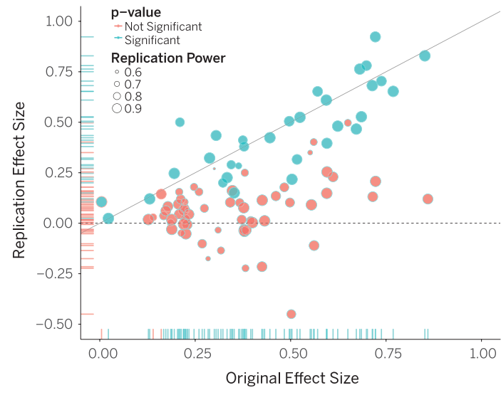
The replication crisis
People got funding to try to replicate results from other groups
Famous example from psychology:
The results only replicated in 36% of cases
All of these studies had
Large samples
Validated measurements
Well designs experiments
Appropriate use of statistics
Open Science Collaboration. (2015). Estimating the reproducibility of psychological science. Science, 349(6251), aac4716–aac4716. https://doi.org/10.1126/science.aac4716

Slide 4
Methodology
Journal | Publisher | SJR | Output (2017)
Wear | Elsevier | 1.558 | 301
Tribology International | Elsevier | 1.382 | 672
Tribology Transactions | Taylor & Francis | 1.061 | 199
Tribology Letters | Springer | 1.016 | 71
Journal of Tribology | ASME | 0.733 | 118
24 assessors
Read 379 randomly selected papers
28% of the output for the selected journals in 2017

Slide 5
Our criteria
Criteria | Possible answers
Were the samples randomised? | Yes/No/NA
Were the tests randomised? | Yes/No/NA
Was any blinding used? | Yes/No/NA
Were control tests completed? | Yes/No/NA
Were tests repeated? | Number of repeats
Were repeats on separate batches of material? | Yes/No/NA
Were any statistics completed? | Yes-descriptive/Yes-test/No/NA
What was the normalised mean difference? | A number

Slide 6
Results
Criteria | Percentage (not including N/As)
Were the samples randomised
Were the tests randomised
Was any blinding used
Were control tests completed
Were tests repeated (n>2)
Were repeats on separate batches of material
Were any statistics completed
2%
1.2%
2.2%
64%
30%
6.1%
9% (4.4% tests)

Slide 7
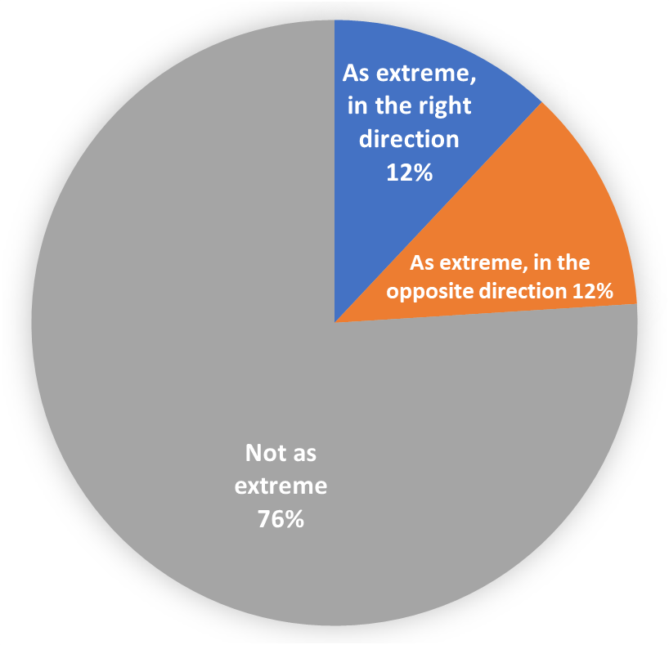
Consequences
ASTM G133 - 05 reciprocating ball on flat wear testing
In laboratory coefficient of variation of 23%
(standard deviation / mean)
Our median study
Sample size of 1
Normalized mean difference of 0.54

Slide 8
What is missing
Our measurements contain variation
Experimenters can be biased

Slide 9
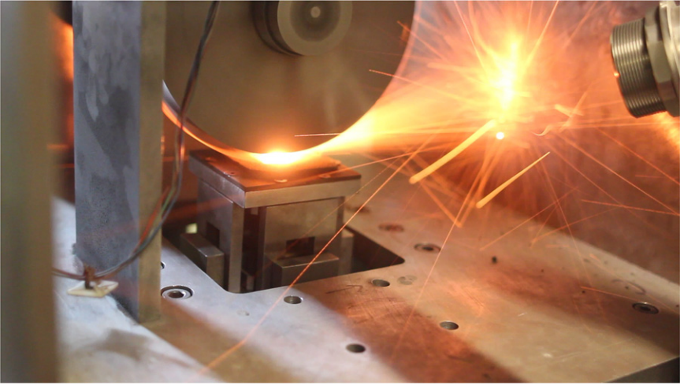
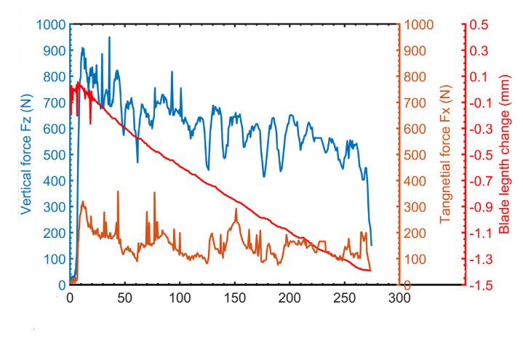
Measurement
μ=0.23
μ=0.23
±0.05
Notes:
When we talk about measurements we often act like they have a single value, if some one asks you how tall you are you
In statistics when we talk about a measurement or a sample from a population we talk about all the processes that lead up to

Slide 10
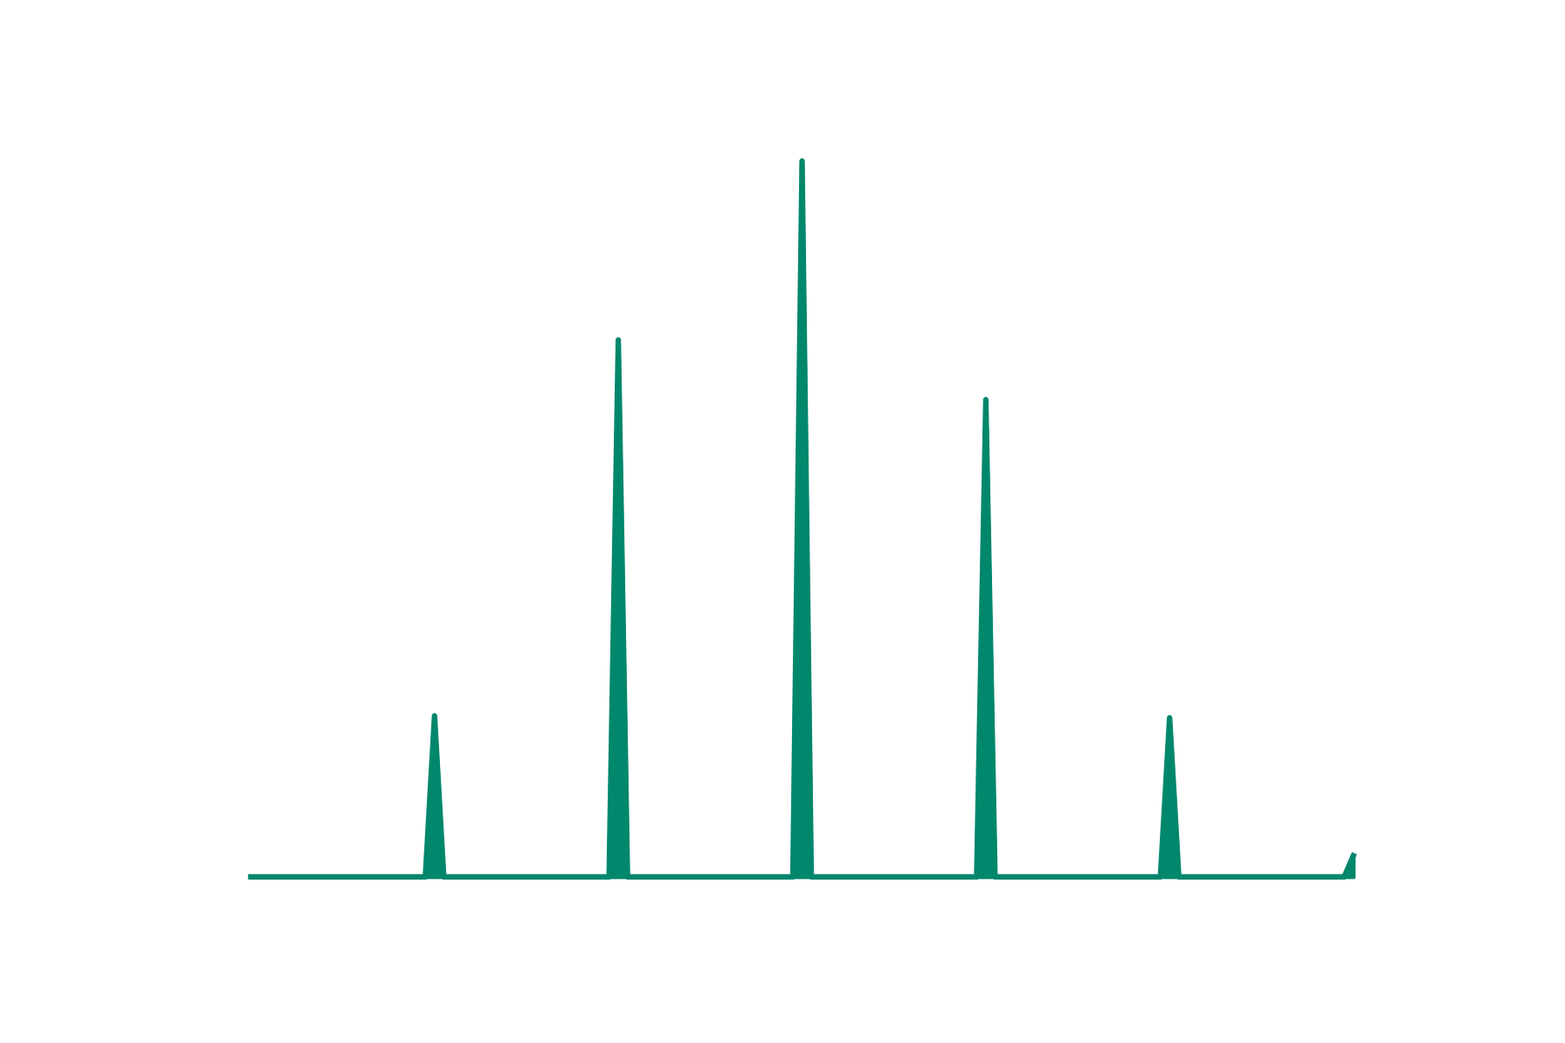

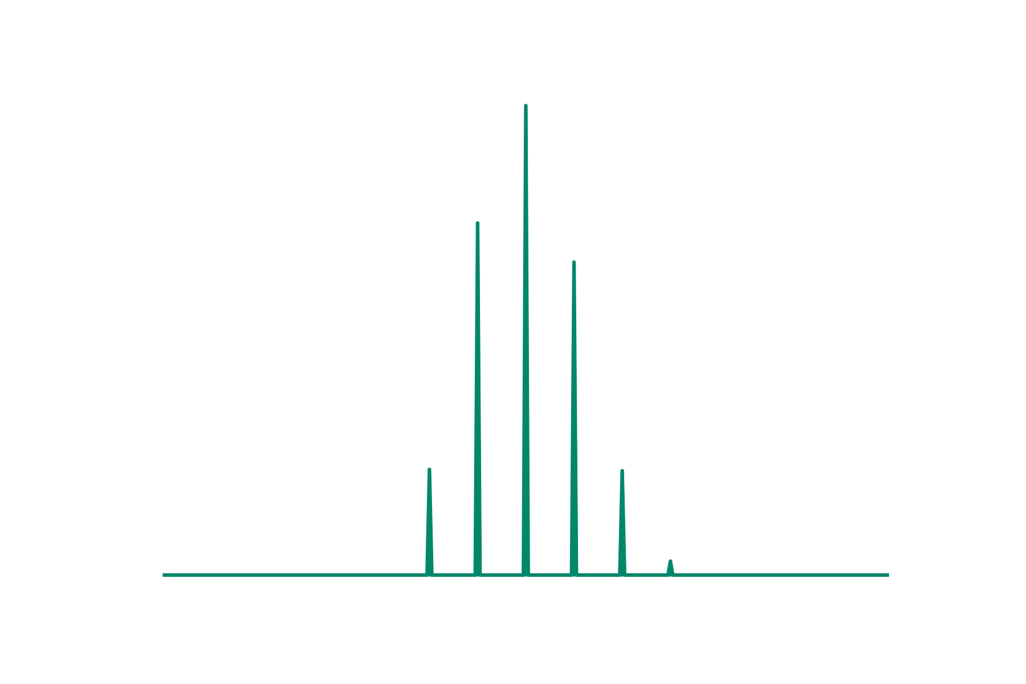
Sources of variation
Notes:
Note that there is variation in the measurement

Slide 11
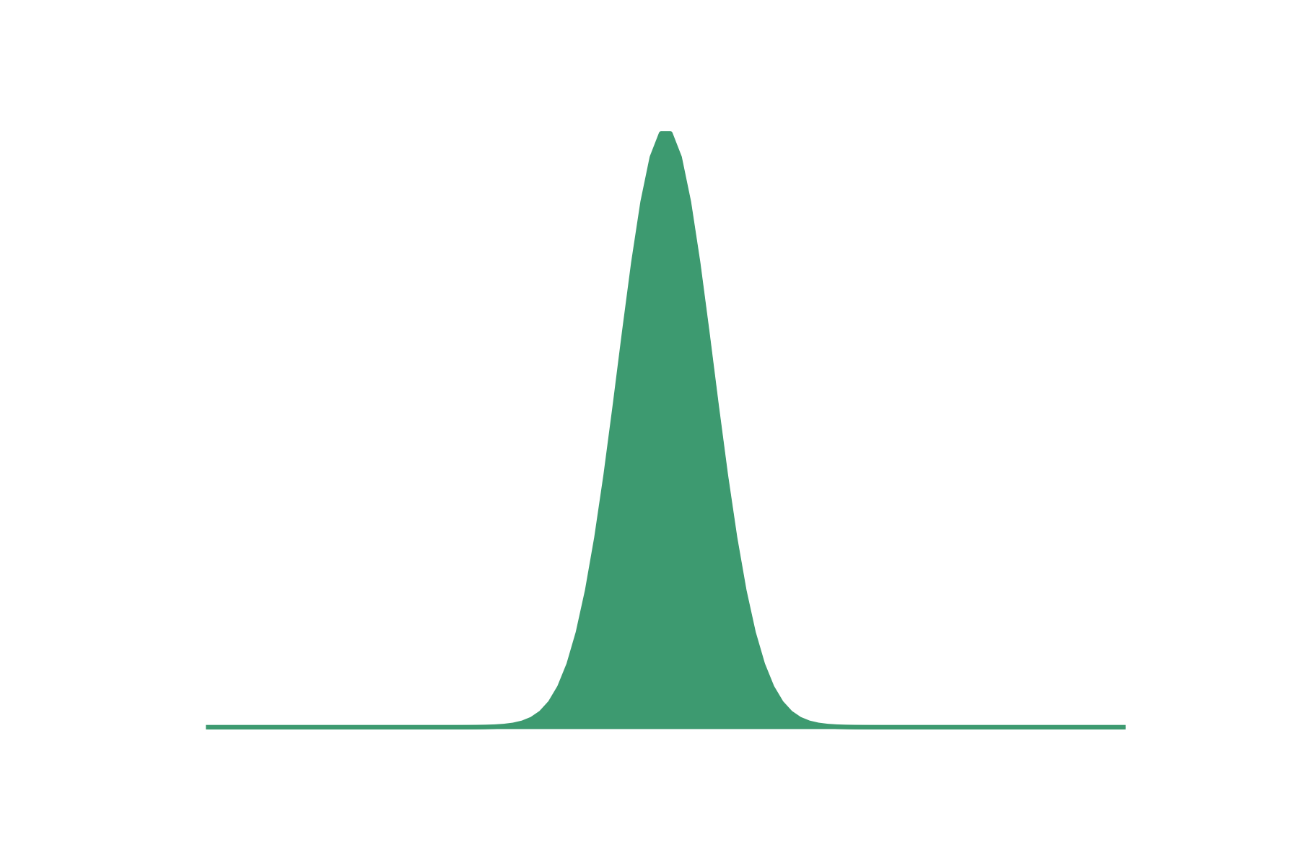

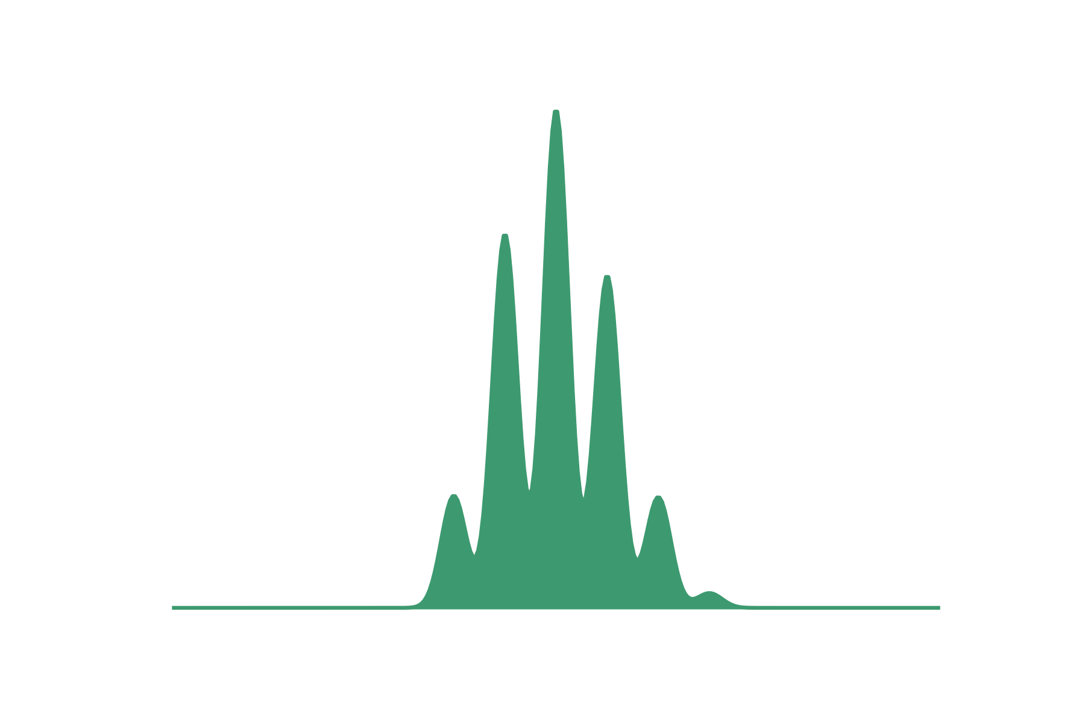
Sources of variation
Notes:
Note that there is variation in the measurement

Slide 12
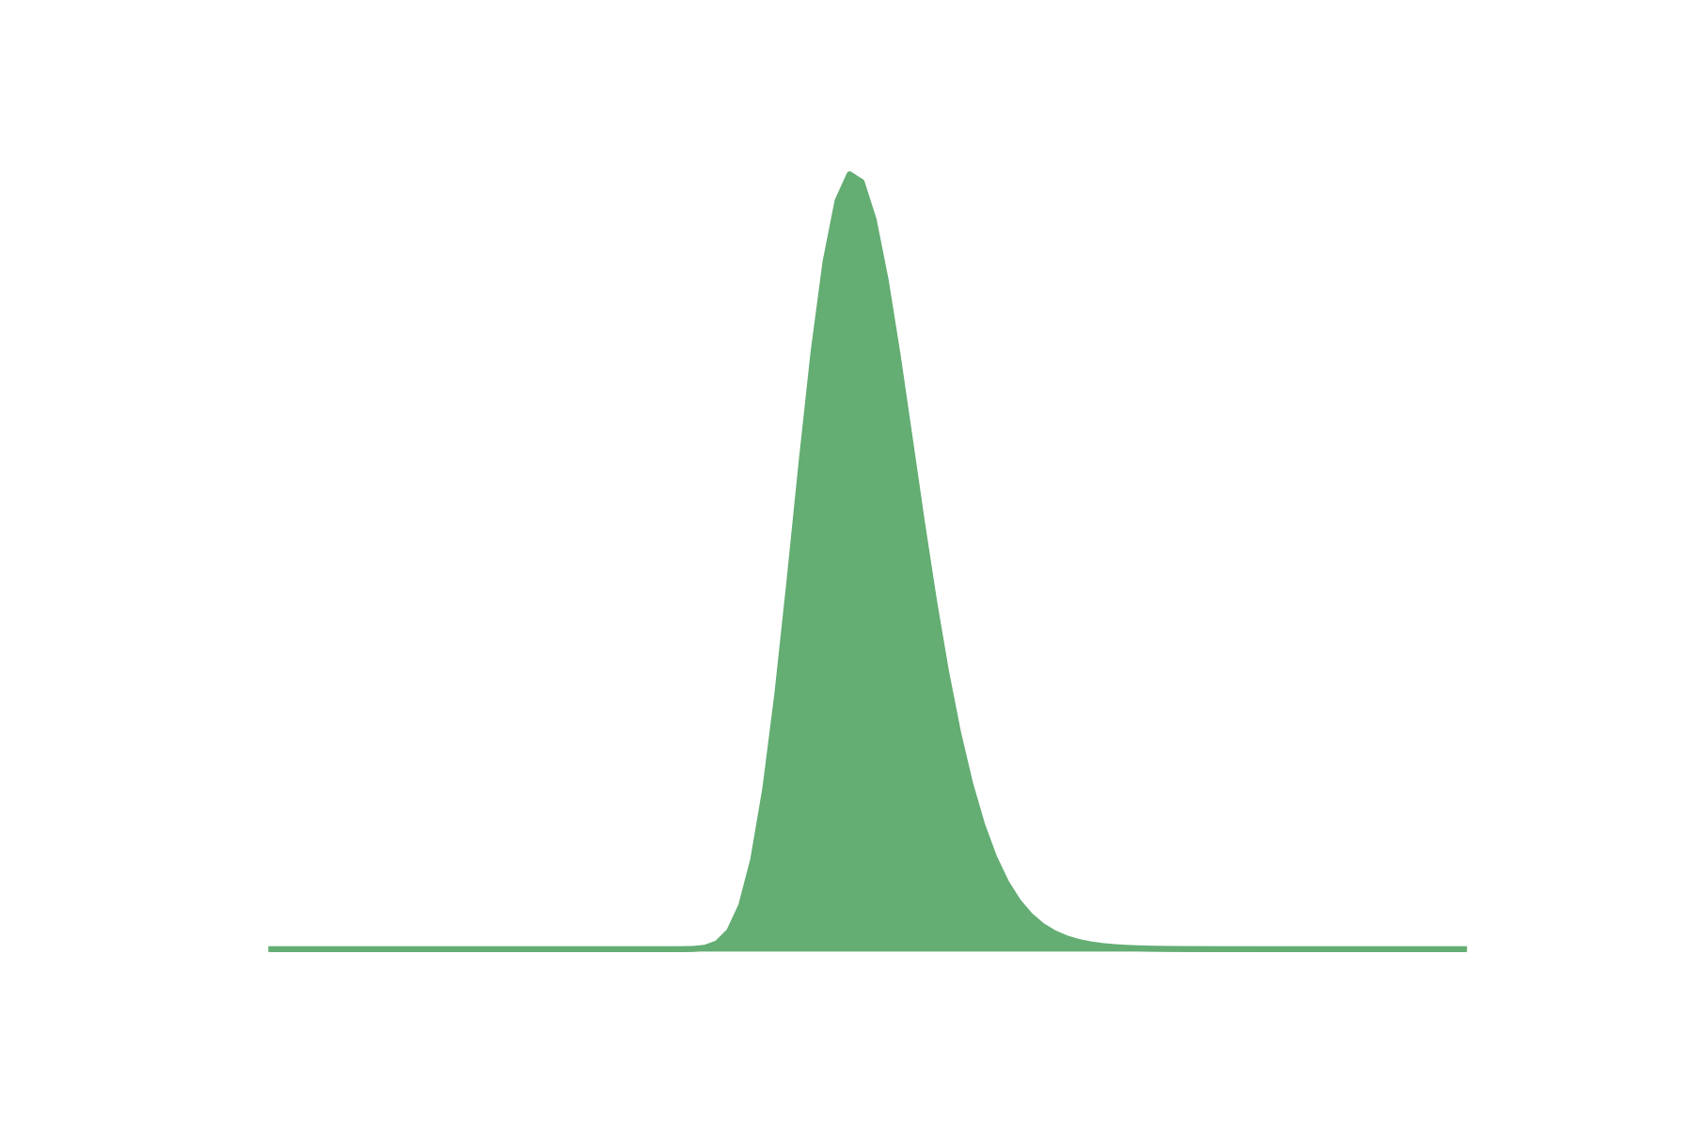

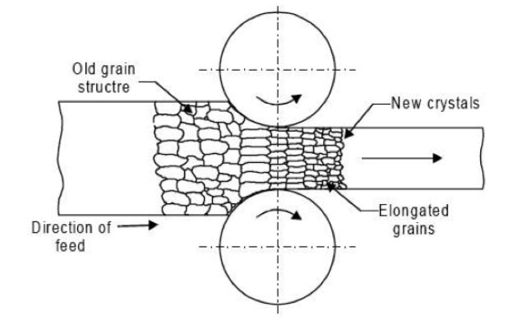
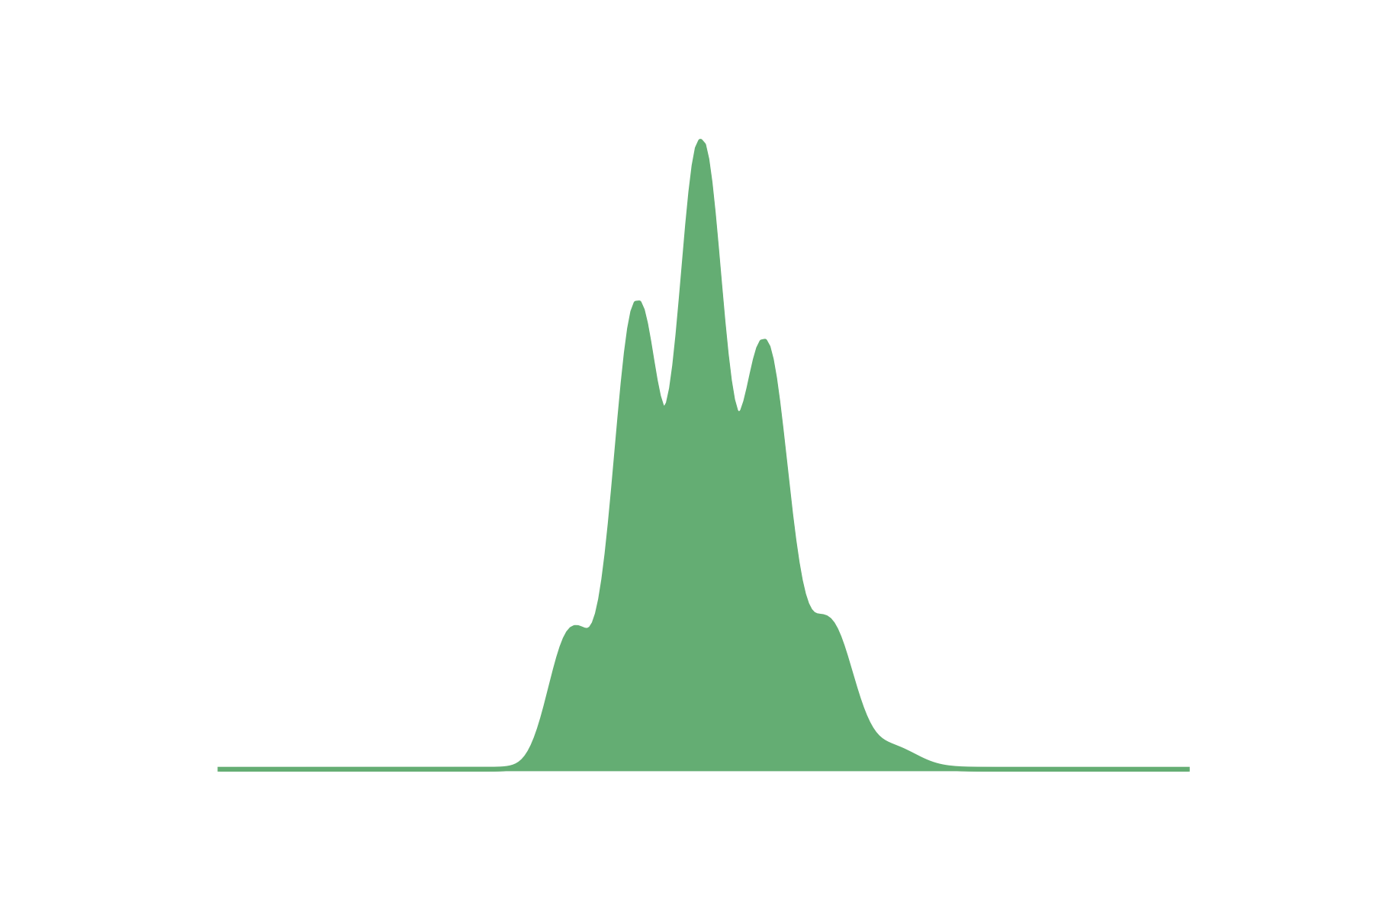
Sources of variation
Notes:
Note that there is variation in the measurement

Slide 13
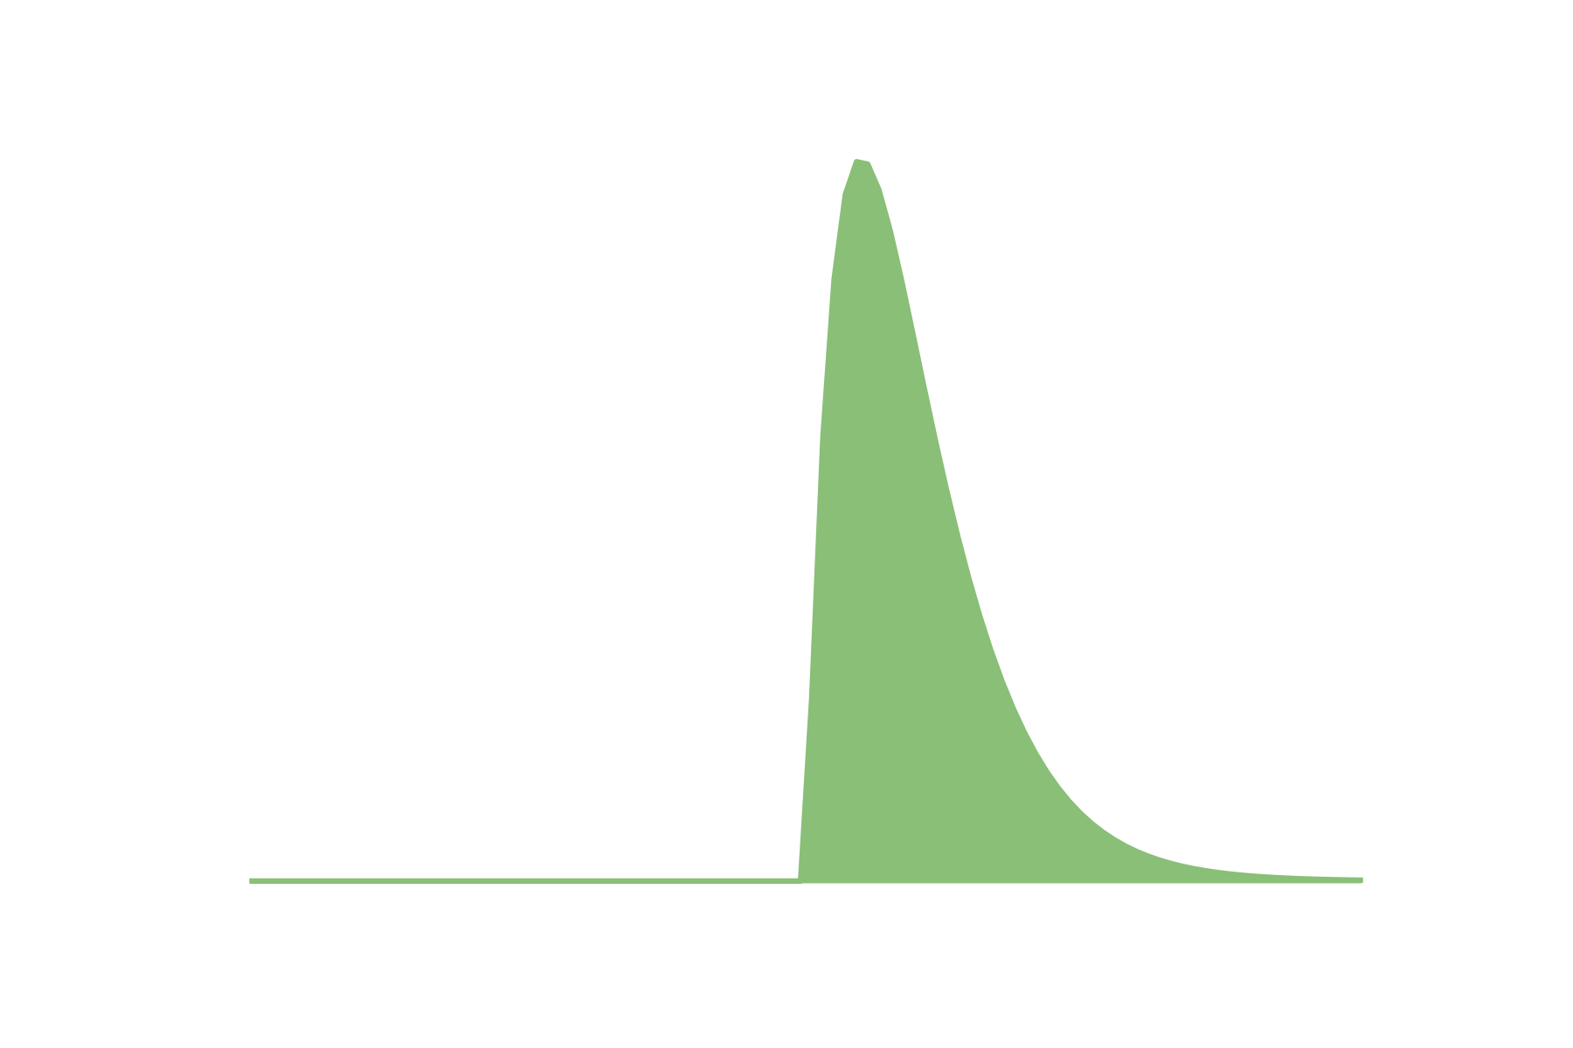
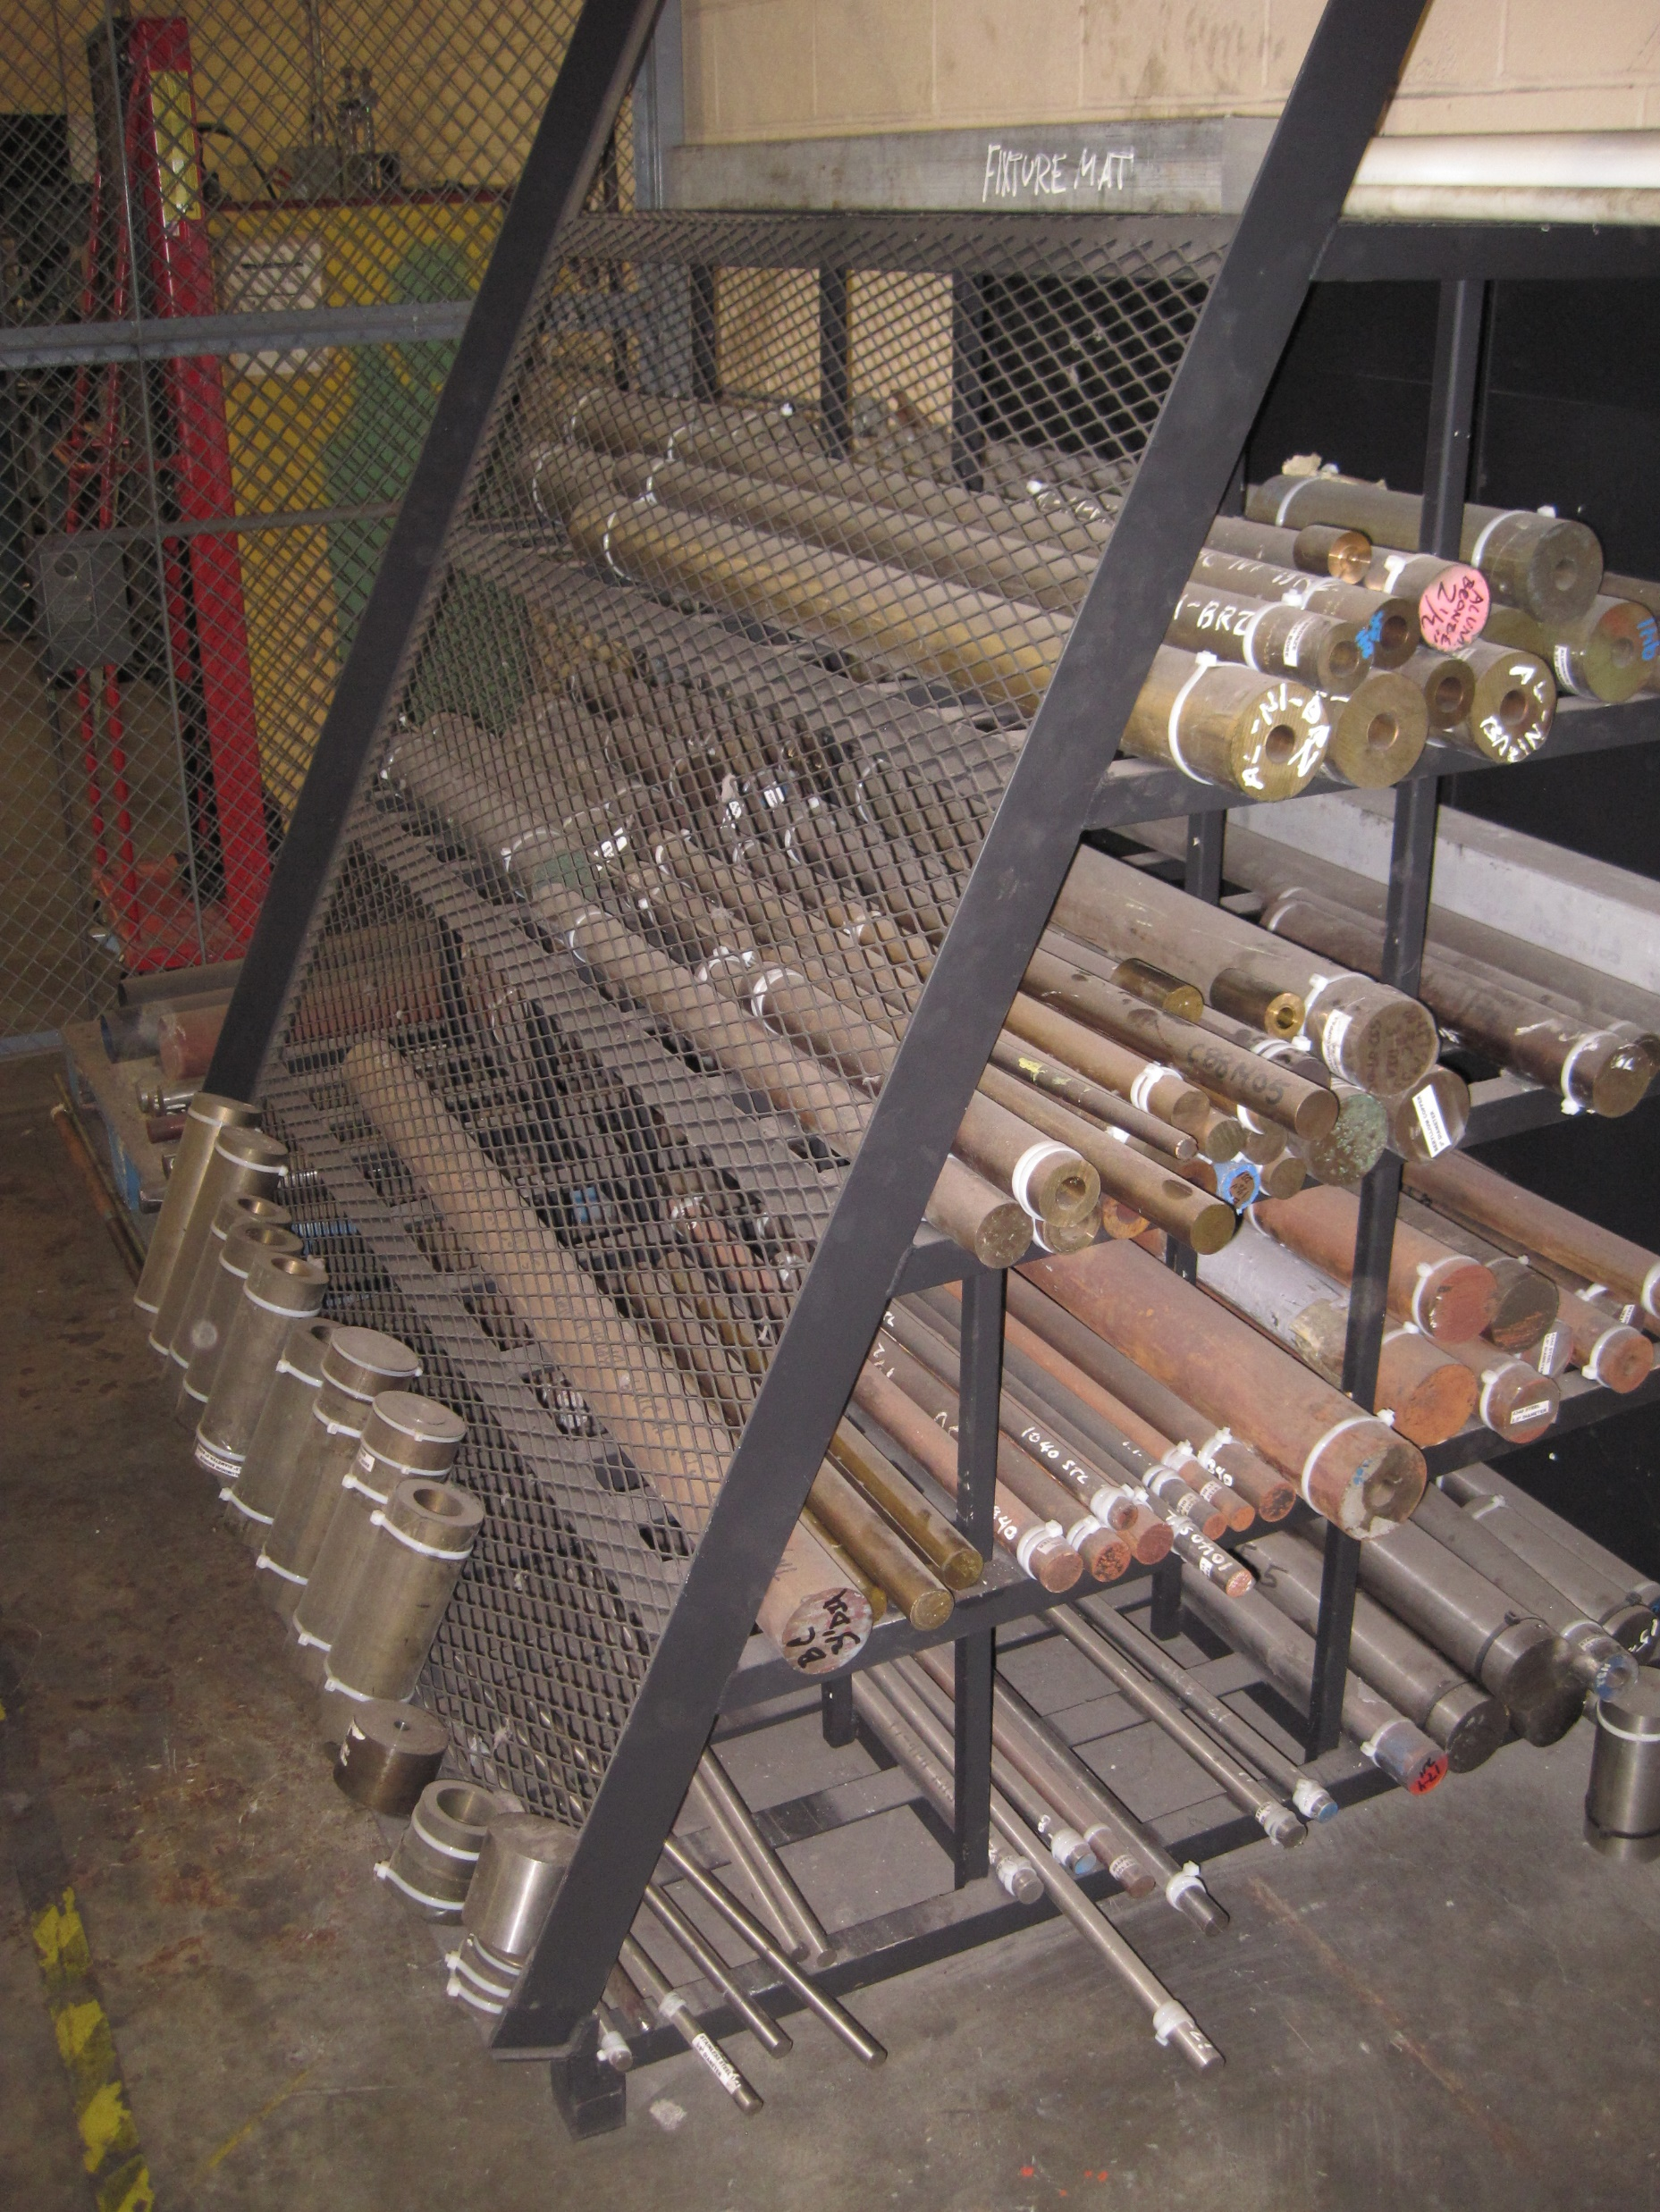
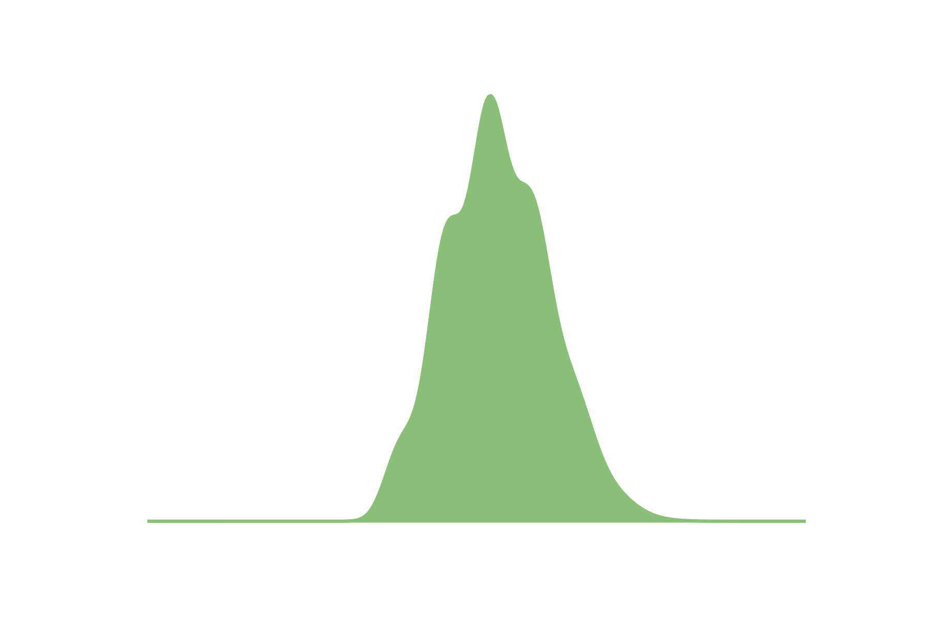
Sources of variation
Notes:
Note that there is variation in the measurement

Slide 14
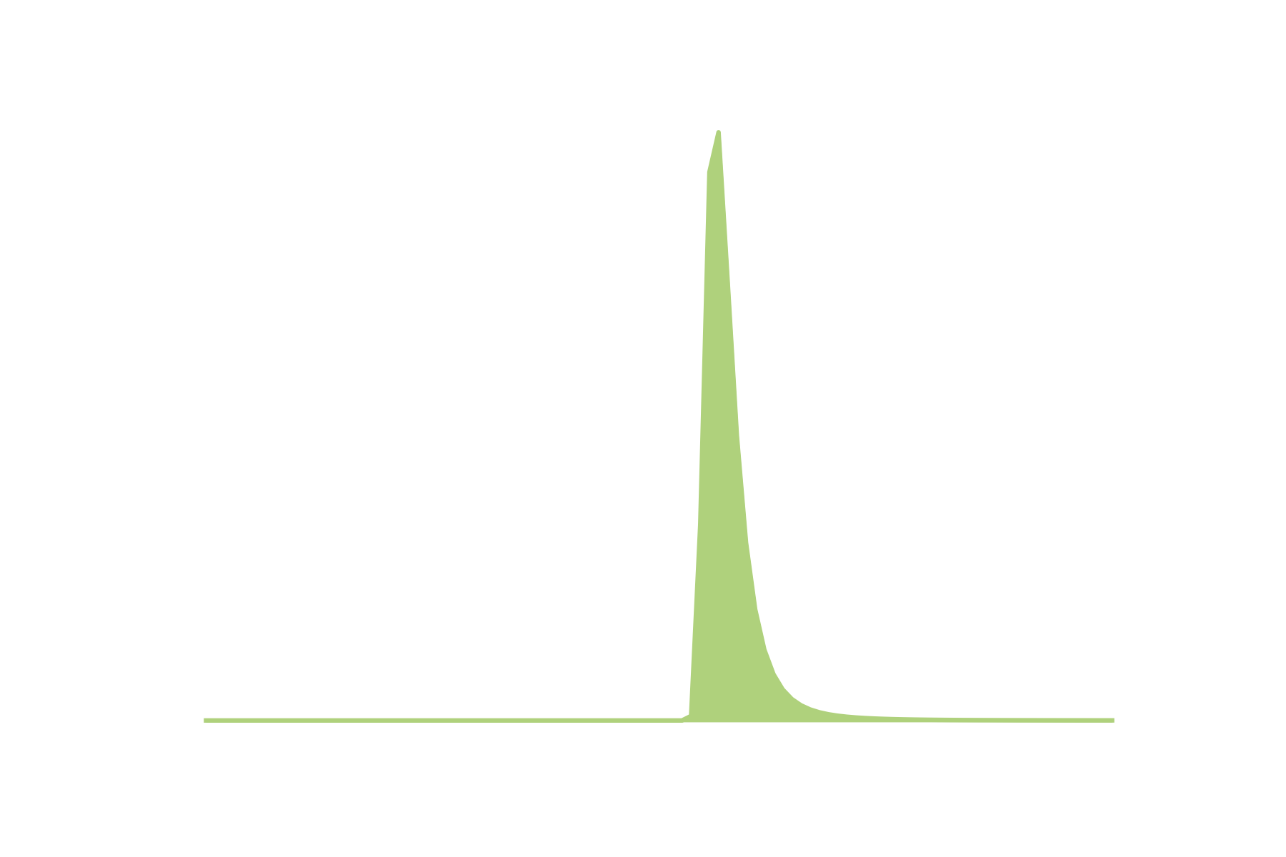
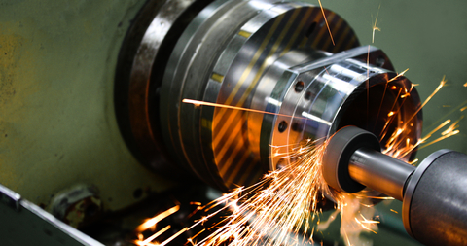
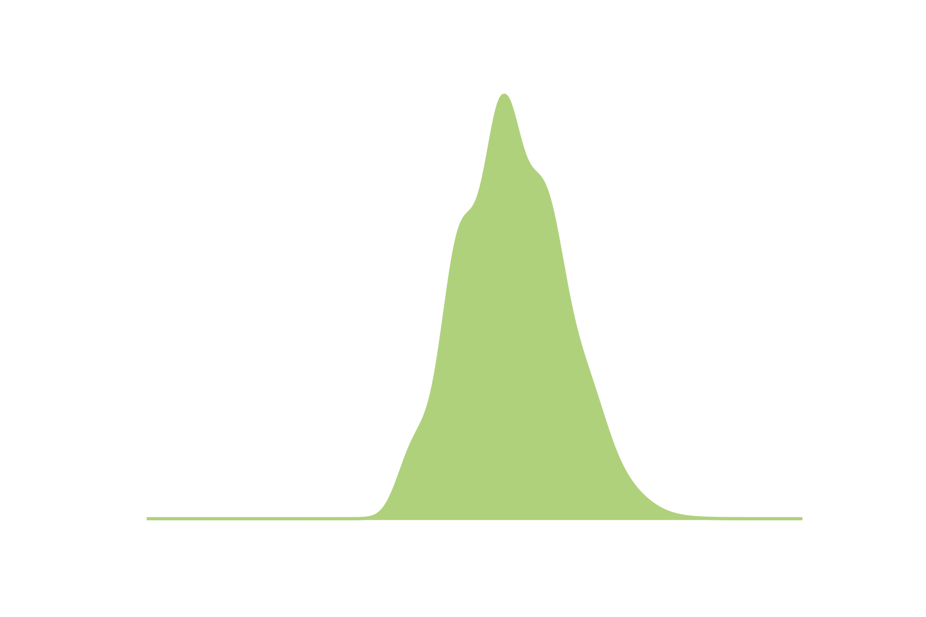
Sources of variation
Notes:
Note that there is variation in the measurement

Slide 15
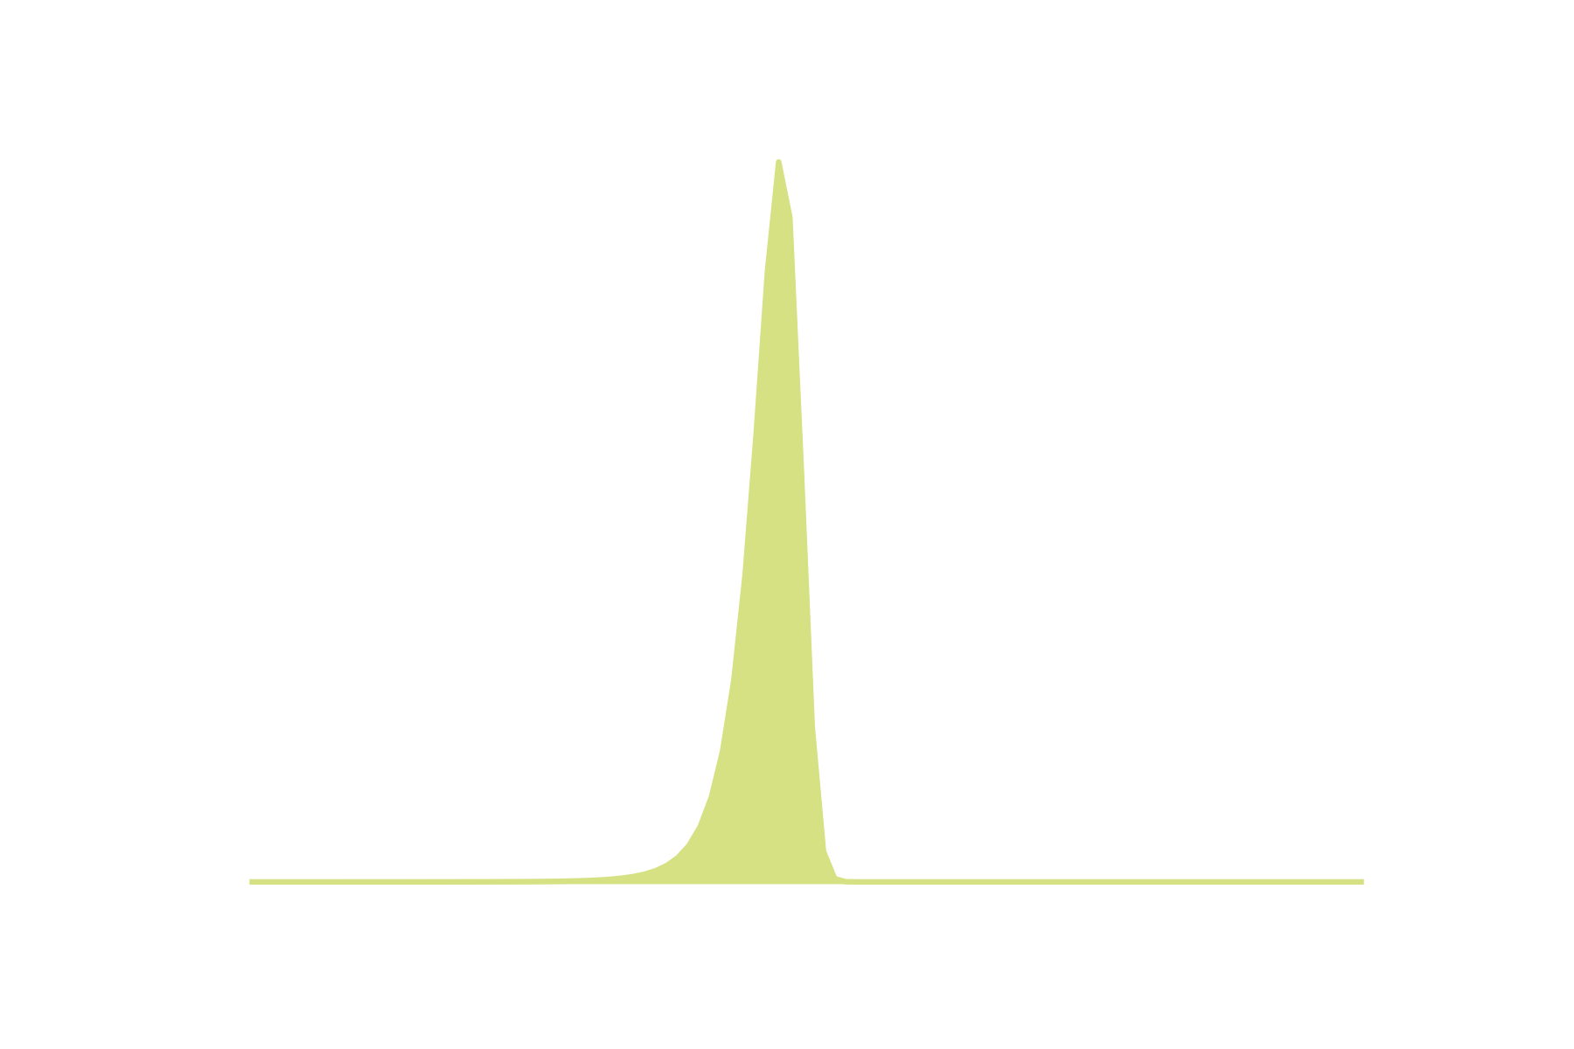
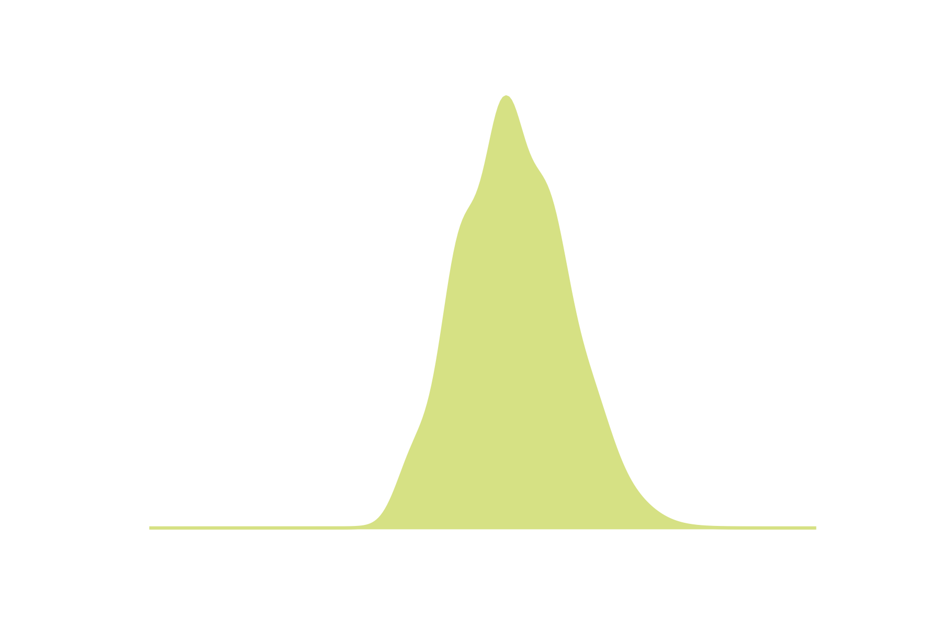
Sources of variation
Notes:
Note that there is variation in the measurement

Slide 16

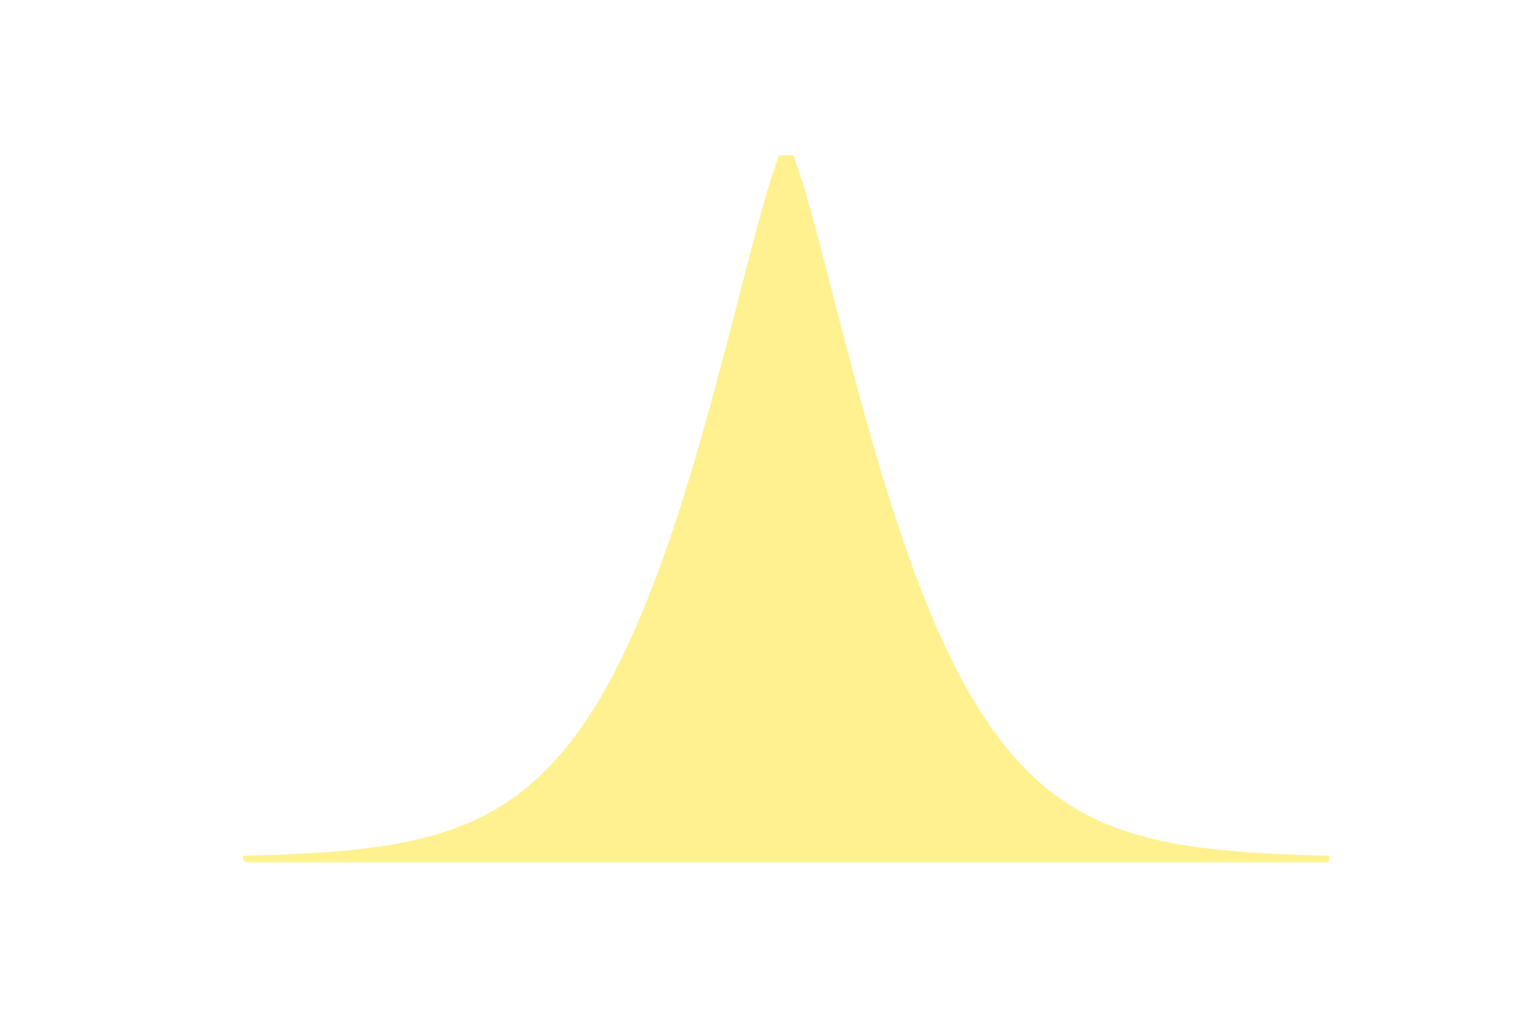
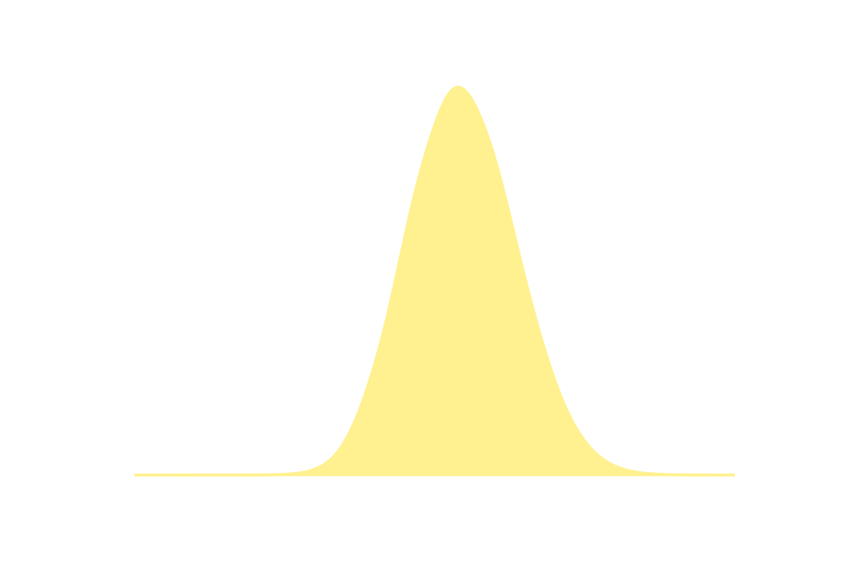
Sources of variation
Notes:
Note that there is variation in the measurement

Slide 17
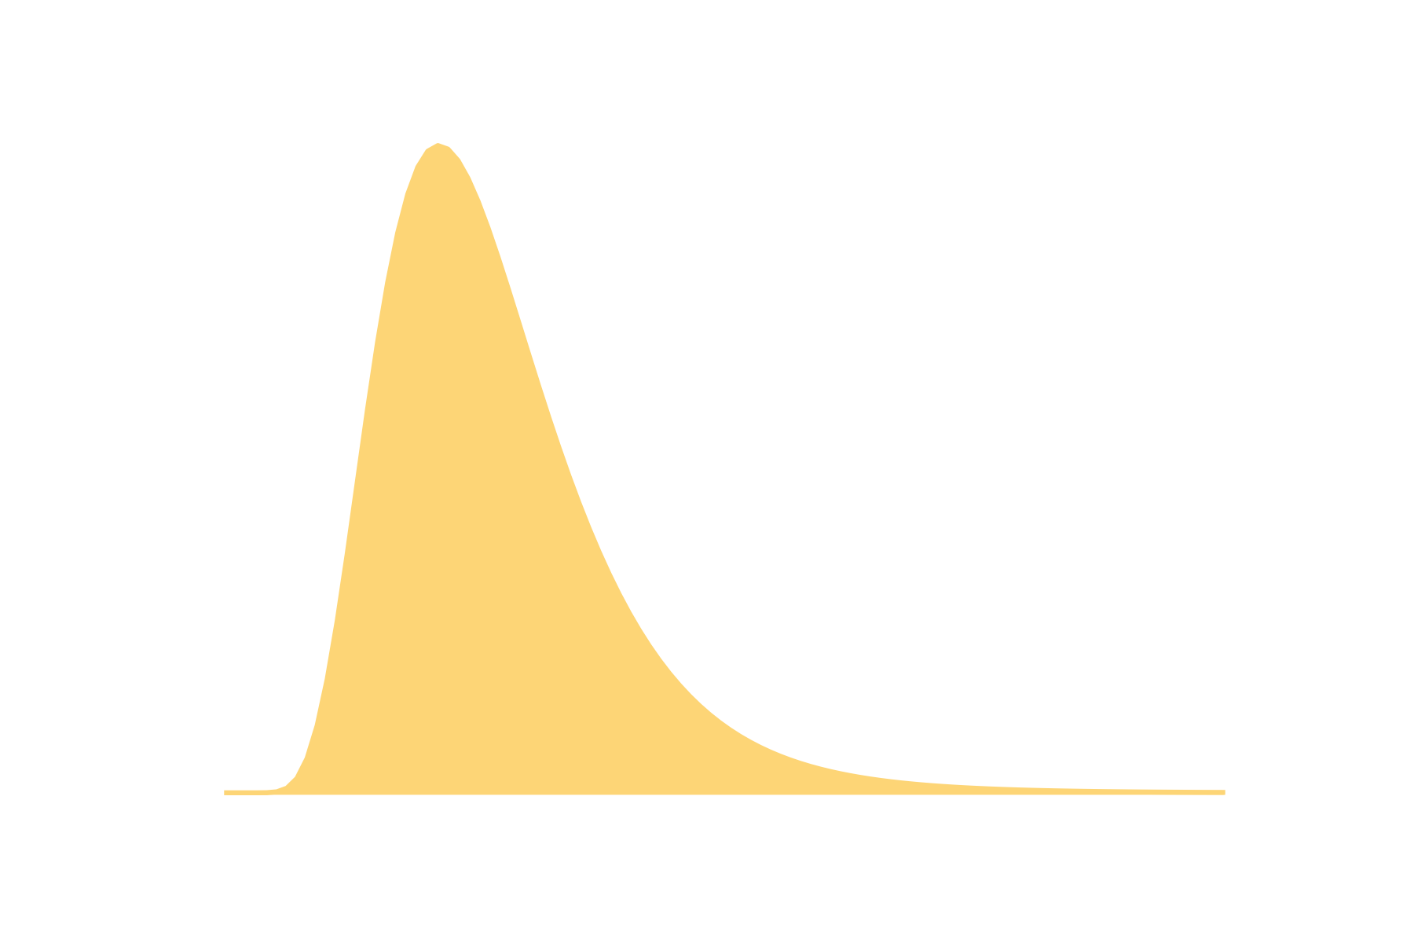
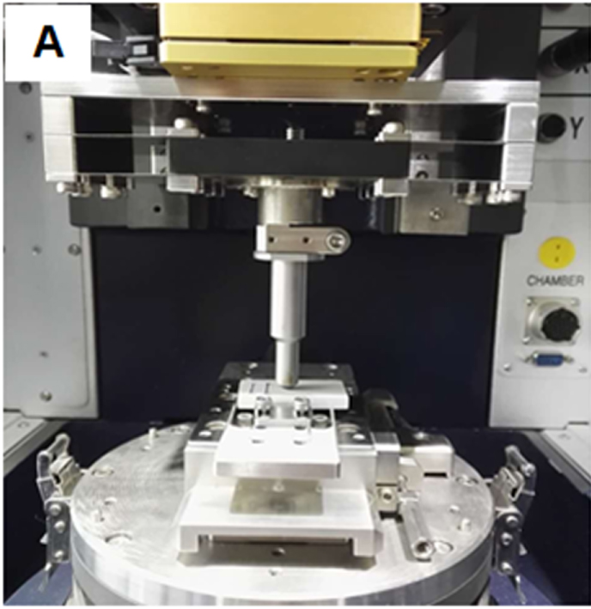
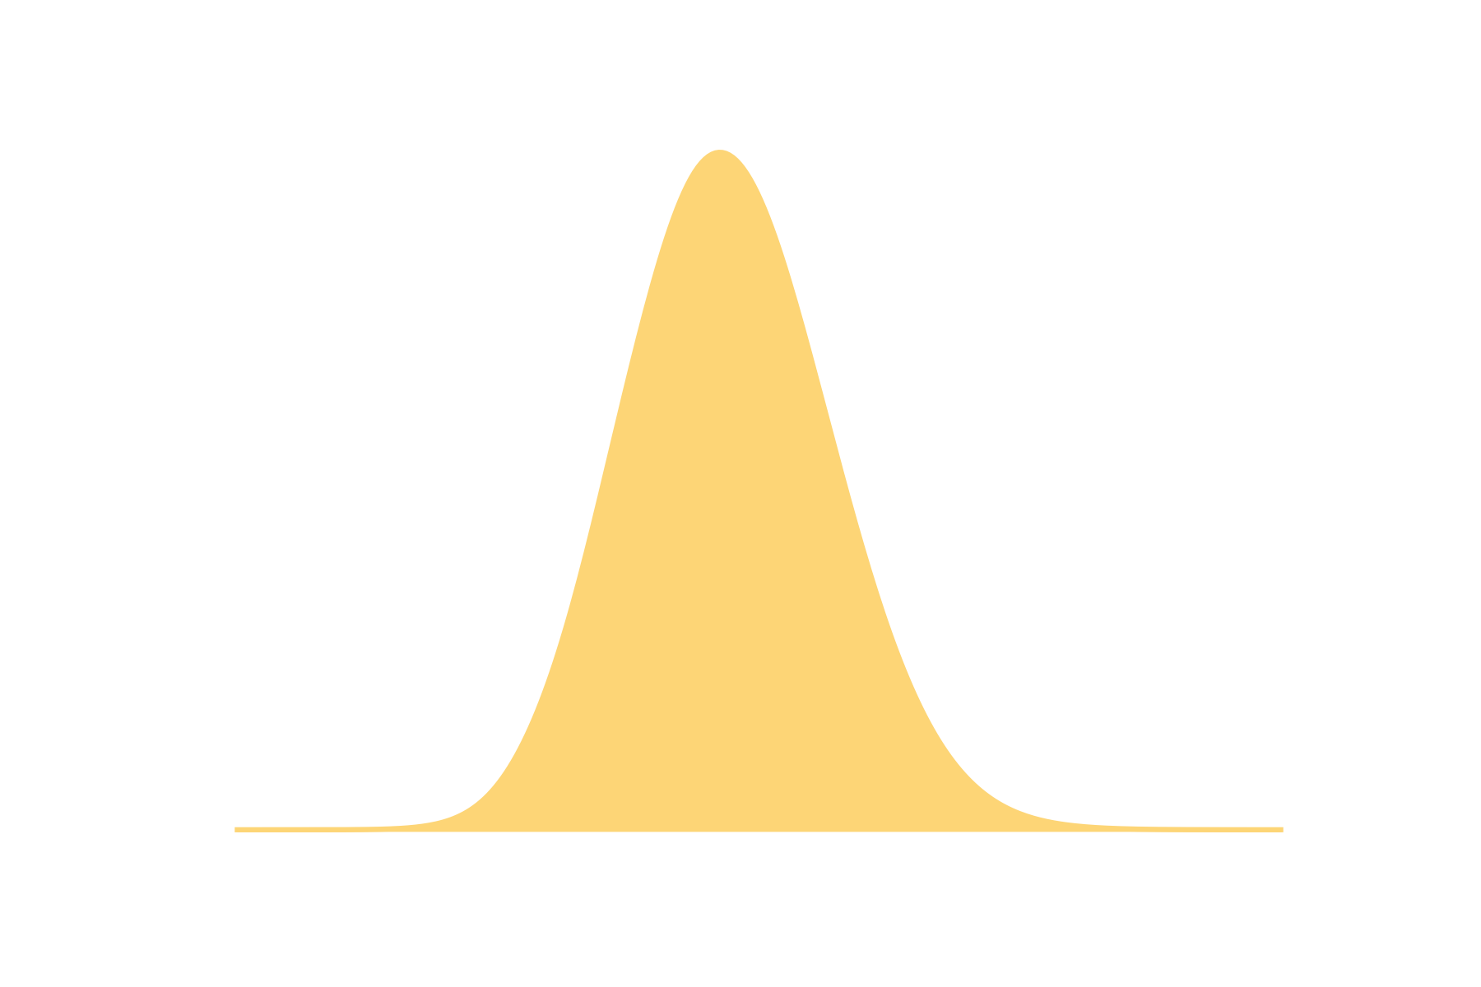
Sources of variation
Notes:
Note that there is variation in the measurement

Slide 18
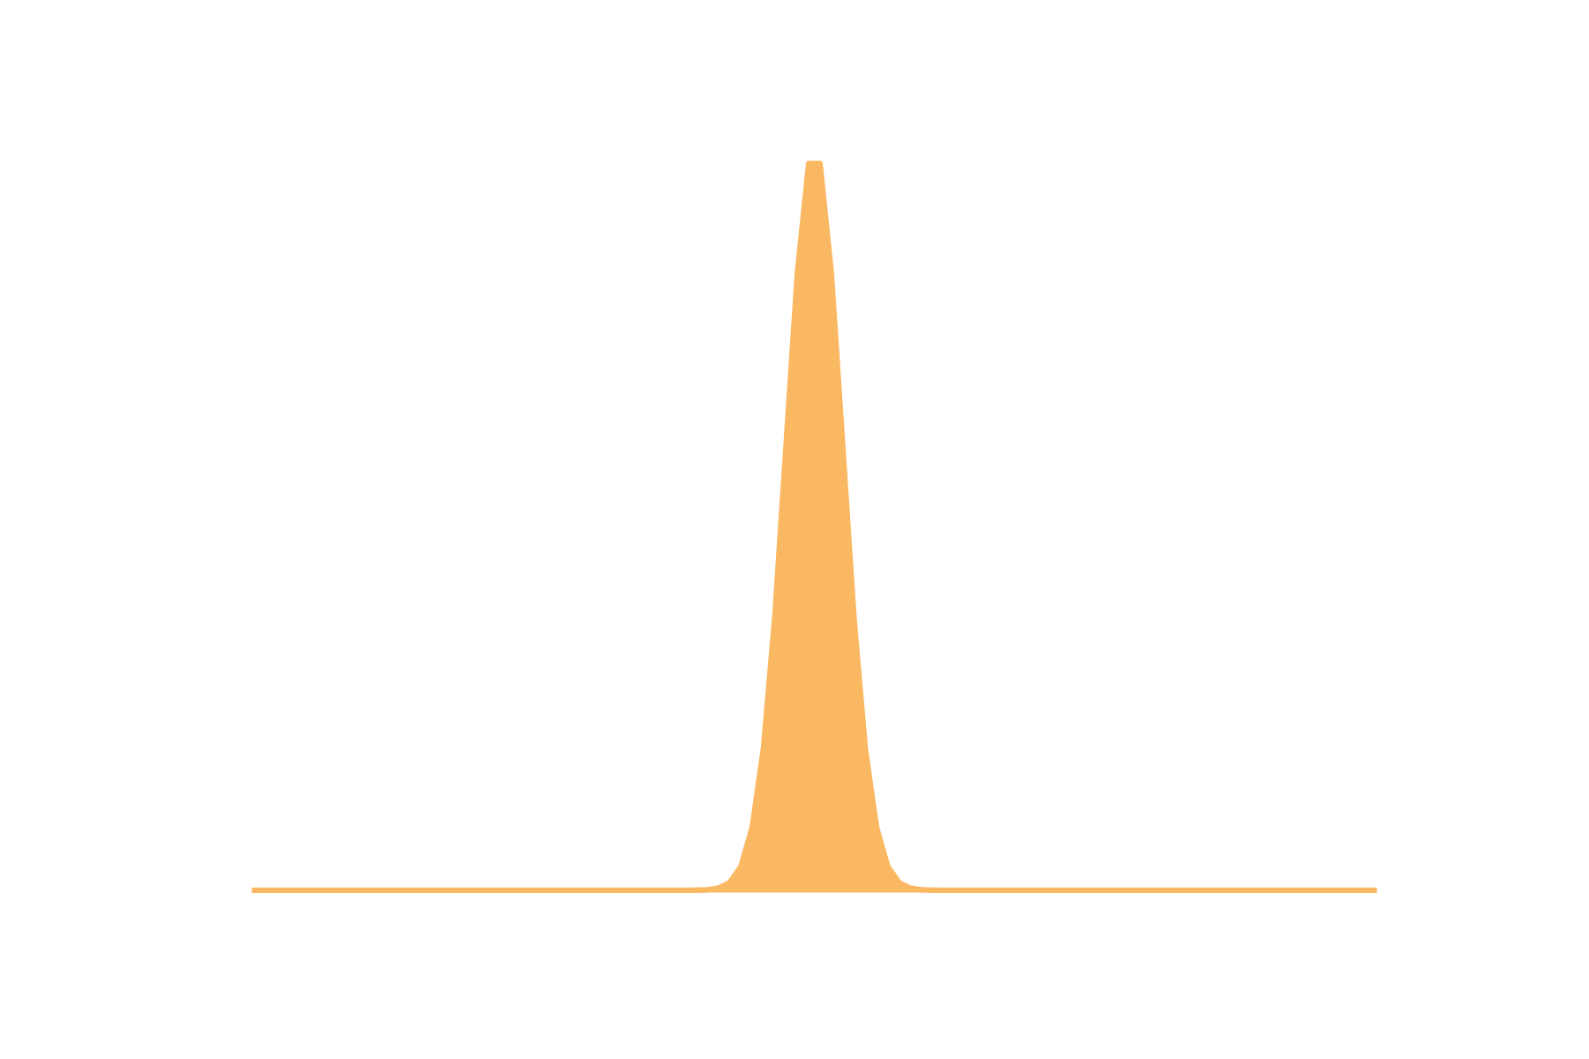


Sources of variation
Notes:
Note that there is variation in the measurement

Slide 19
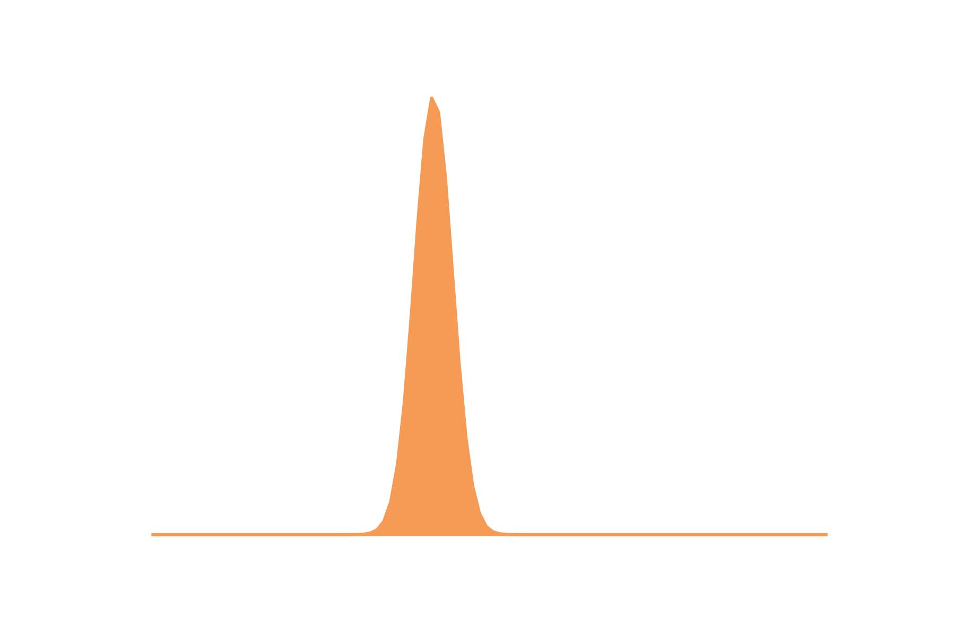
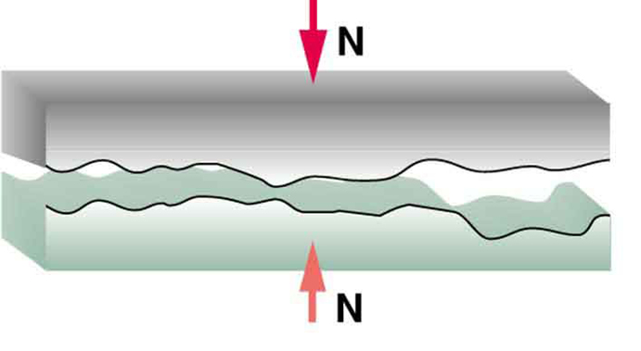
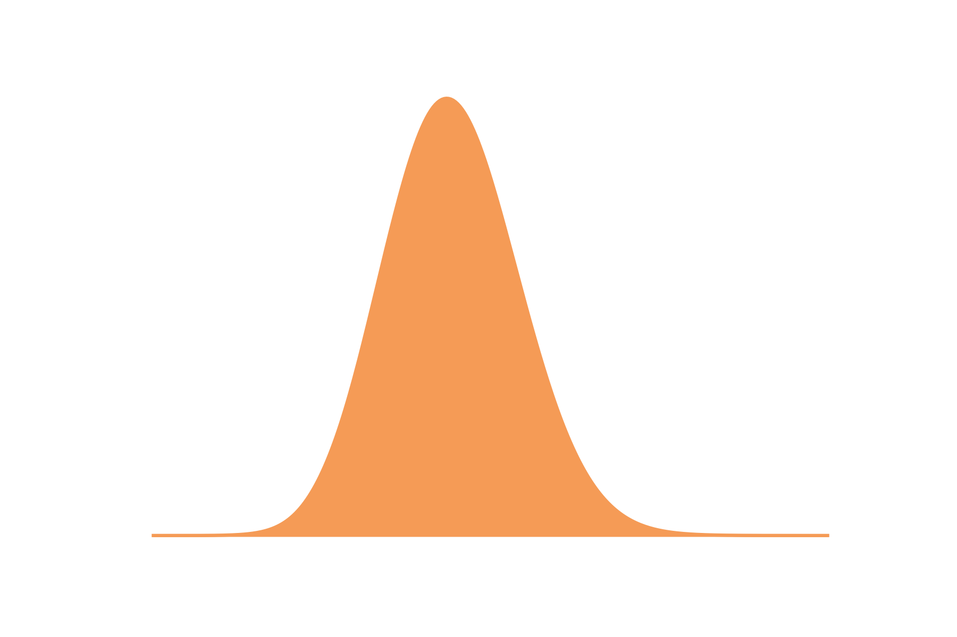
Sources of variation
Independent variables
(the ones you intend to change)
Notes:
Note that there is variation in the measurement

Slide 20
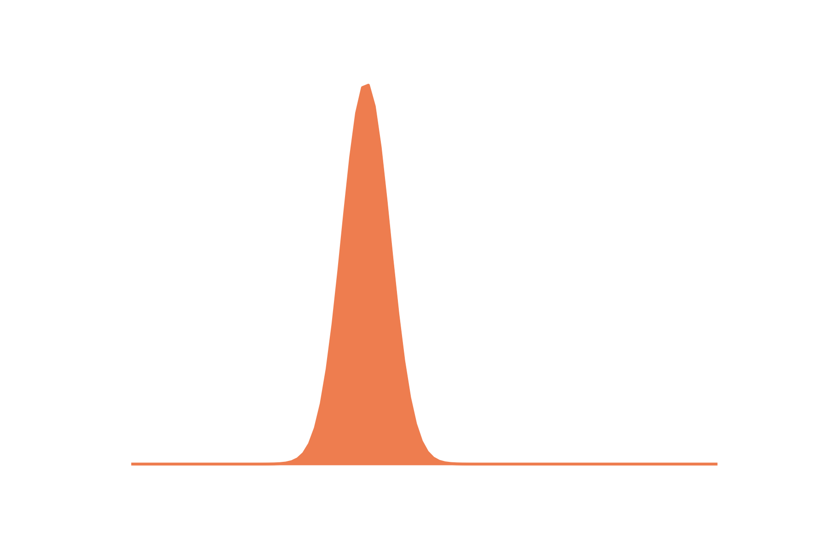
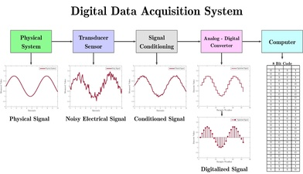

Sources of variation
Notes:
Note that there is variation in the measurement

Slide 21
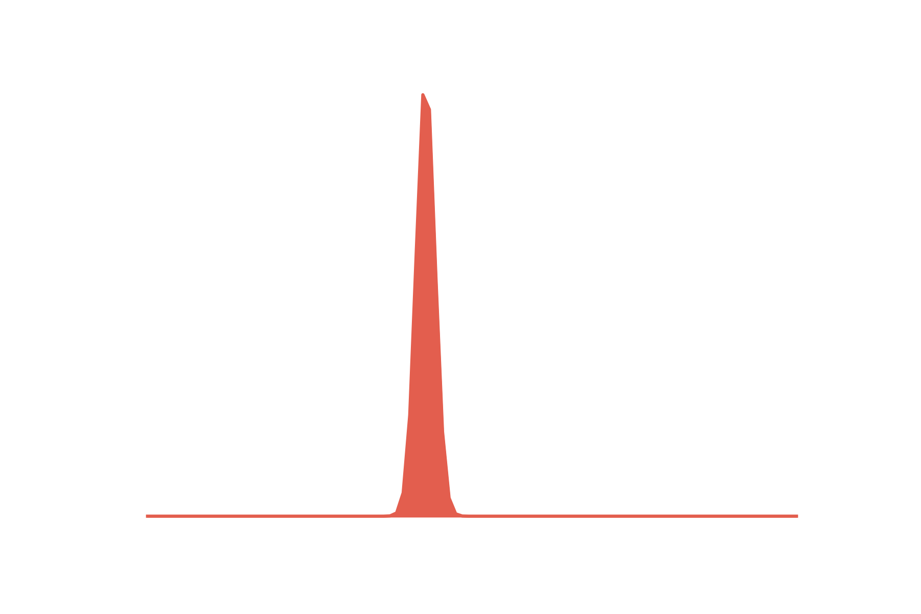
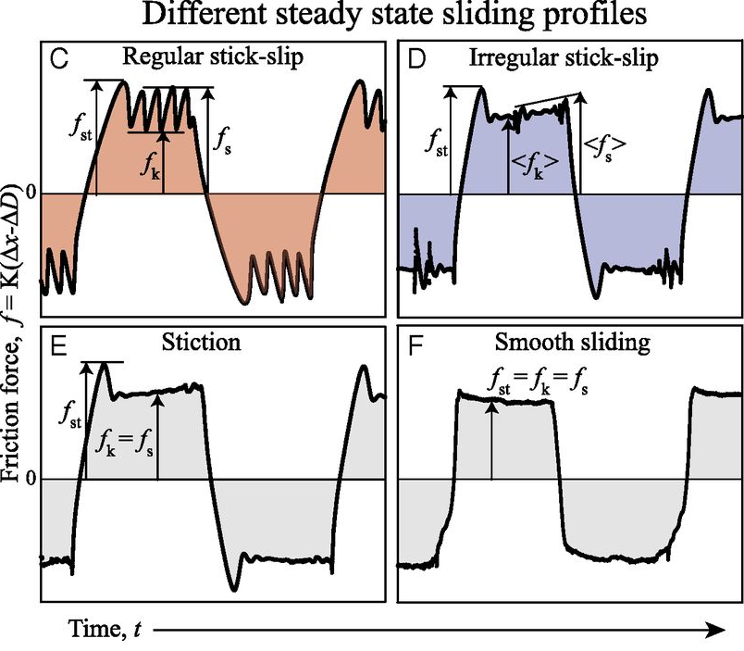

Sources of variation
Notes:
Note that there is variation in the measurement

Slide 22
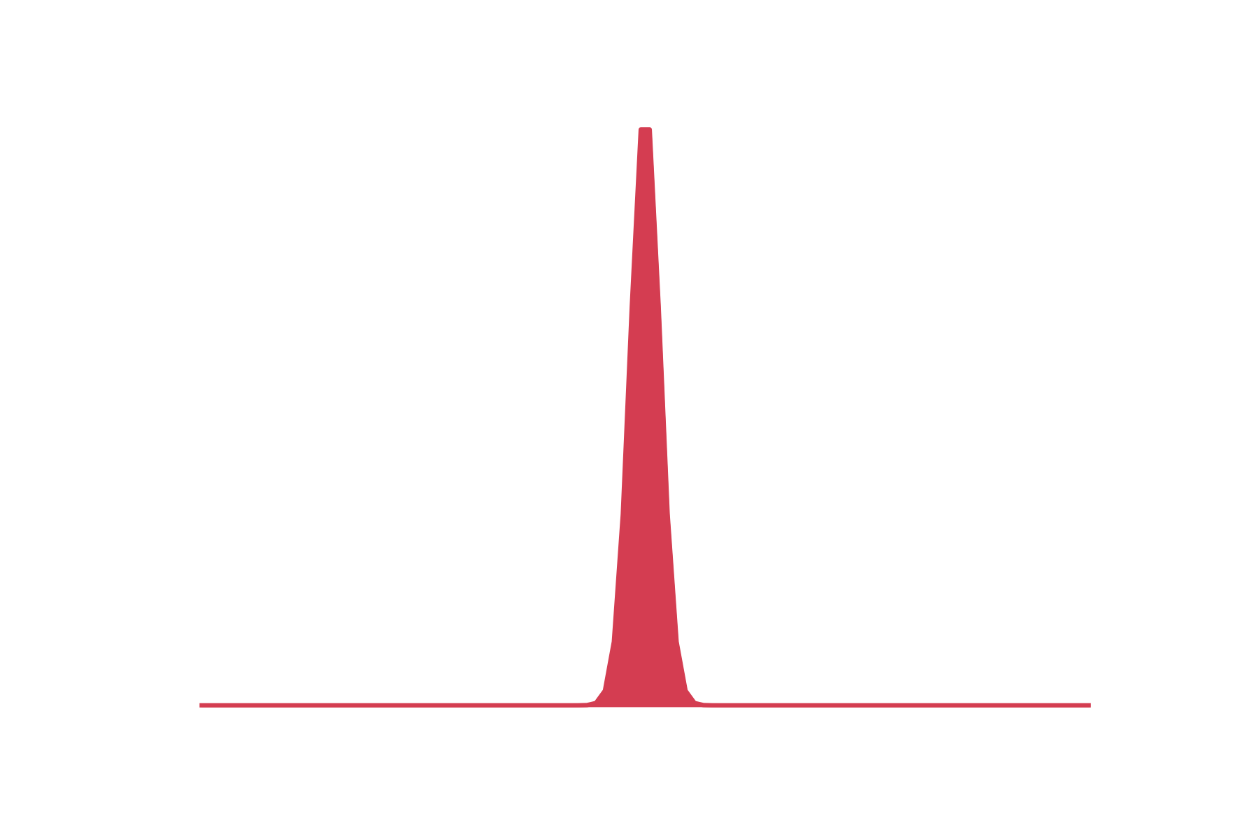
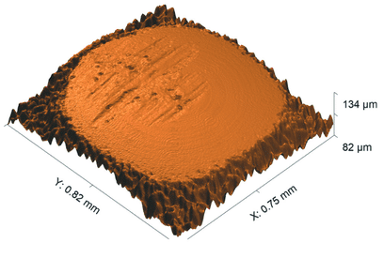

Sources of variation

Slide 23
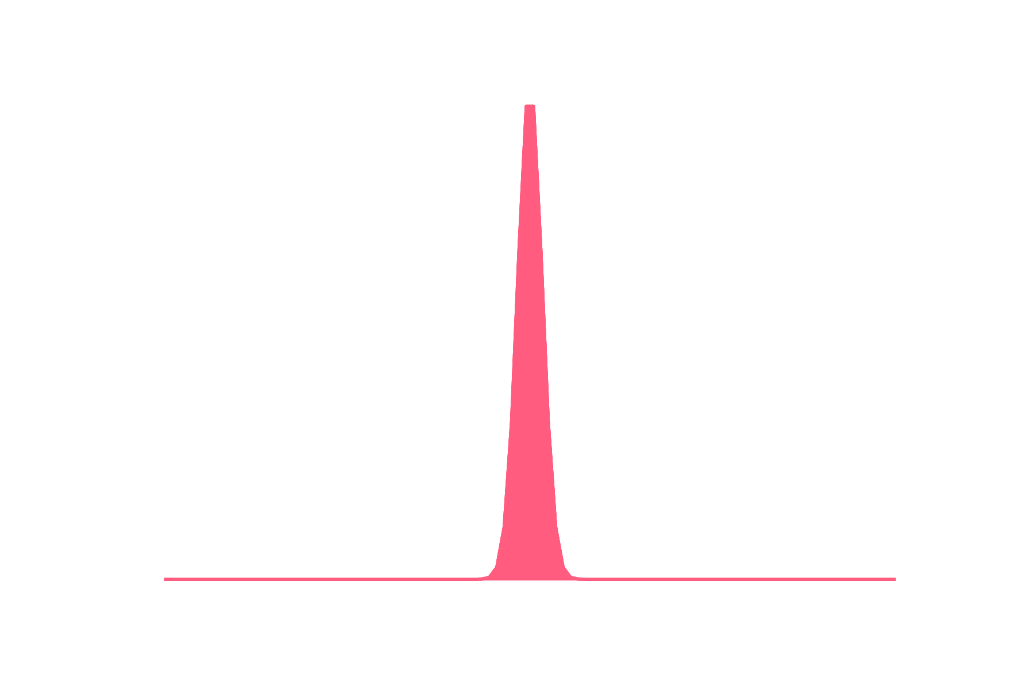

Sources of variation
The distribution of our sample
μ=0.23
±0.05
The distribution of the population of
possible valid measurements
Notes:
Note that there is variation in the measurement but this is

Slide 24
Why we do this
System with lots of variation
Difficult to learn about
System with little variation
Easy to learn about
Notes:
Good reasons to do some of these things, if every time we wanted to run an experiment we had to take a new sample from a randomly selected ore mine and take it to a randomly selected mill, it would be a huge pain to run an experiment. And at the end of it our results would contain a lot of variation that we weren’t interested in.
it is really difficult to learn anything important about a system with a lot of variation, you need to run lots of repeats to get a clear idea of what is happening, where as a system with very little variation
but there are better methods of doing this than pretending that the variation doesn’t exist
And actually in tribology we often don’t know which one of these regimes we are in, because we take such small samples.

Slide 25
What is a biased experiment
Bias happens when:
We have failed to account for variation
Two or more sources of variation are mixed up
The thing we intended to vary and something we didn’t think about
Interactions between sources are important
E.g. a process that eliminates some samples
Our samples don’t represent the population well

Slide 26
What is missing
Our measurements contain variation
Experimenters can be biased

Slide 27
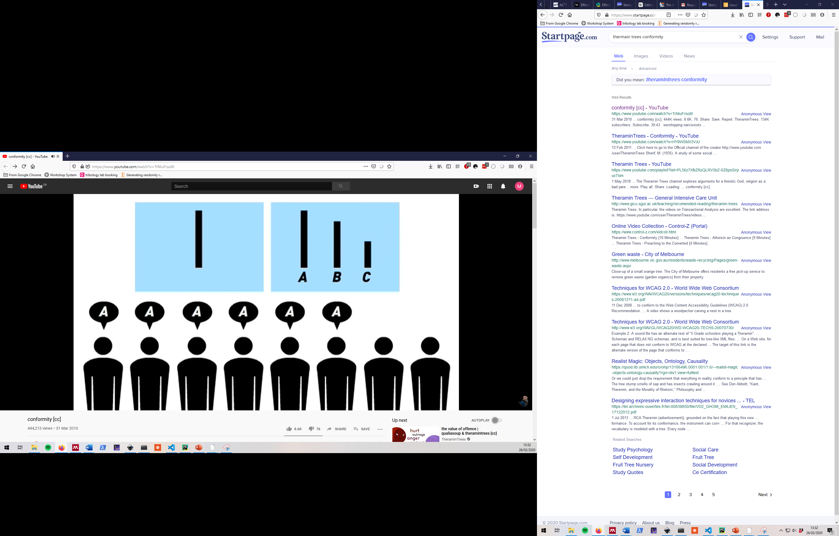
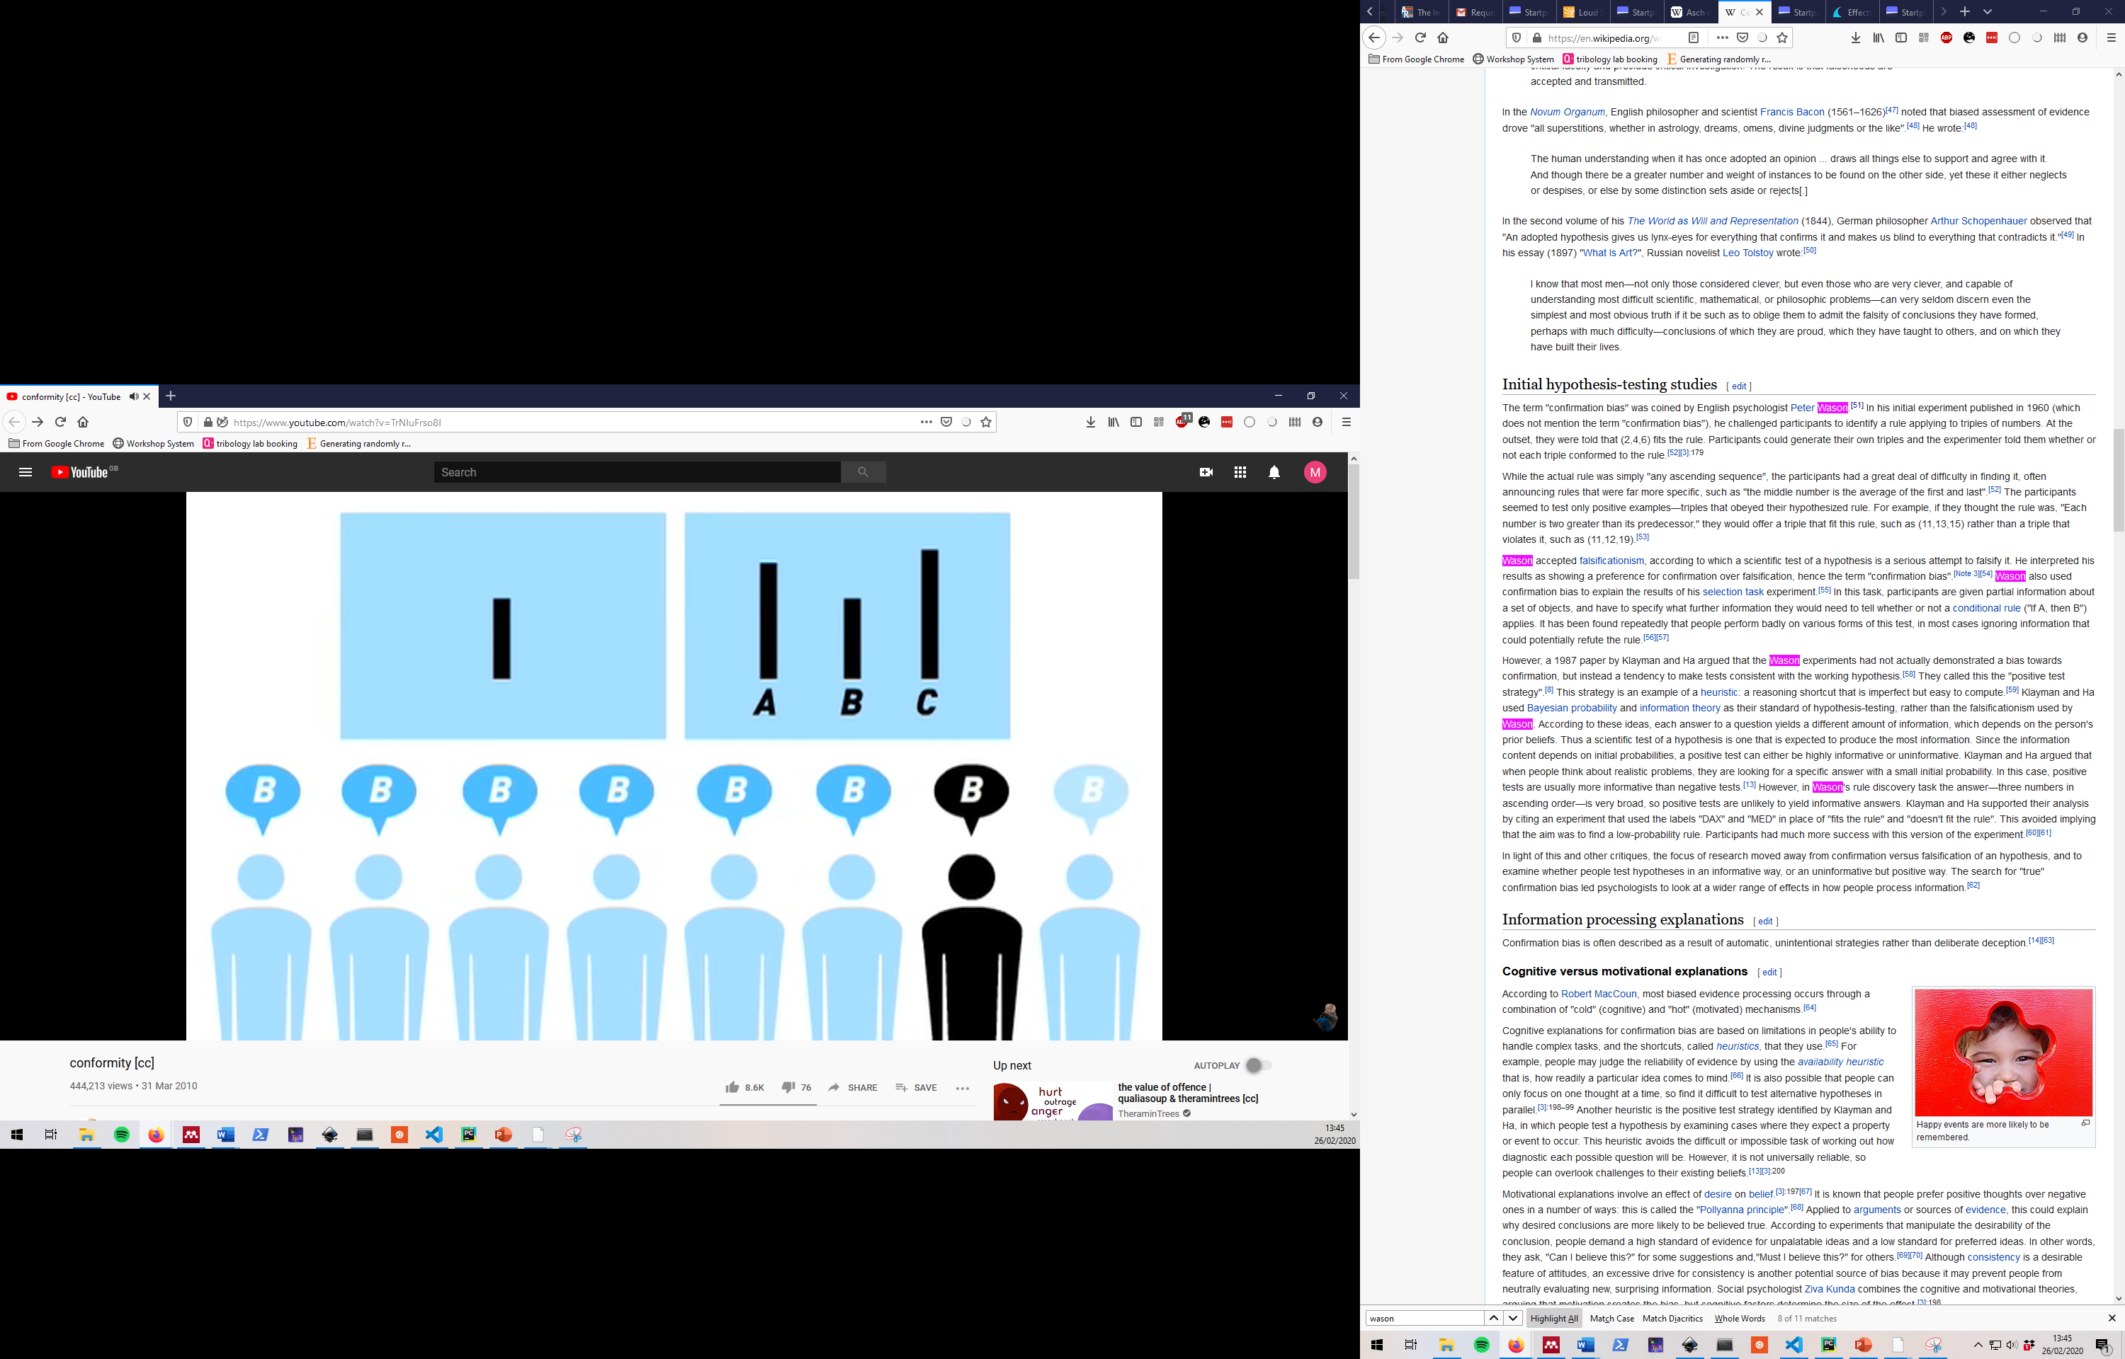
Experimenter bias (That’s us)
Asch, S. E. (1951). Effects of group pressure upon the modification and distortion of judgments. In H. Guetzkow (Ed.), Groups, leadership and men; research in human relations (p. 177–190). Carnegie Press.
Notes:
25 % of people agree with the group all the time 75% of people get it wrong at least once in 12 tests. Now obviously we shouldn’t think that this applies to all people all the time, that would be falling into the trap we just talked about. But we should realise that we have no reason to think we are less biased than this.
I also want you to think about

Slide 28

Why might you be biased
This thesis would be a lot easier to write if…
When the best thing to do isn’t clear bias can point us in the wrong direction
And the best thing to do is often not clear
Notes:
We like to think of ourselves as mostly objective and we all know that when asked everyone in this room would say that the truth is the most important thing to find. But we should acknowledge that we have biases towards certain things, we might have a pet idea that we want to see succeed. Or we might just be coming to the end of a PhD and knowing that getting positive results will make the difference between feeling good about the project, and having an easy time writing and feeling bad about the project.
The point is our experiments are tied to a lot of real world outcomes that directly affect our lives.
I’m not saying that this would cause anyone in this room to make up data or falsify results. But you are all studying complex systems, there are a lot of judgement calls to be made and this bias can affect which way they are made. For example if a machine was showing an unusually high value and making a strange noise you might stop it if you are familiar with the material but you may let it carry on for a new material. Or if you are running a statistical analysis that you don’t really understand you might change settings if they give you the result that you want

Slide 29
What makes a good experiment
A fair and relevant measurement
An unbiased experiment
A design that lets you model what you need
A fair modelling process
Notes:
A fair and relevant measurement, and this is measurement in the statistical point of view
An experiment that is not open to bias
A design of experiment that lets you model what you need to model
And a fair modelling process that you understand

Slide 30
Removing bias from the measurement
A fair and relevant measurement
An unbiased experiment
A design that lets you model what you need
A fair modelling process
Notes:
Note that you are using the word test technically wrong and this is normally called the measurement

Slide 31
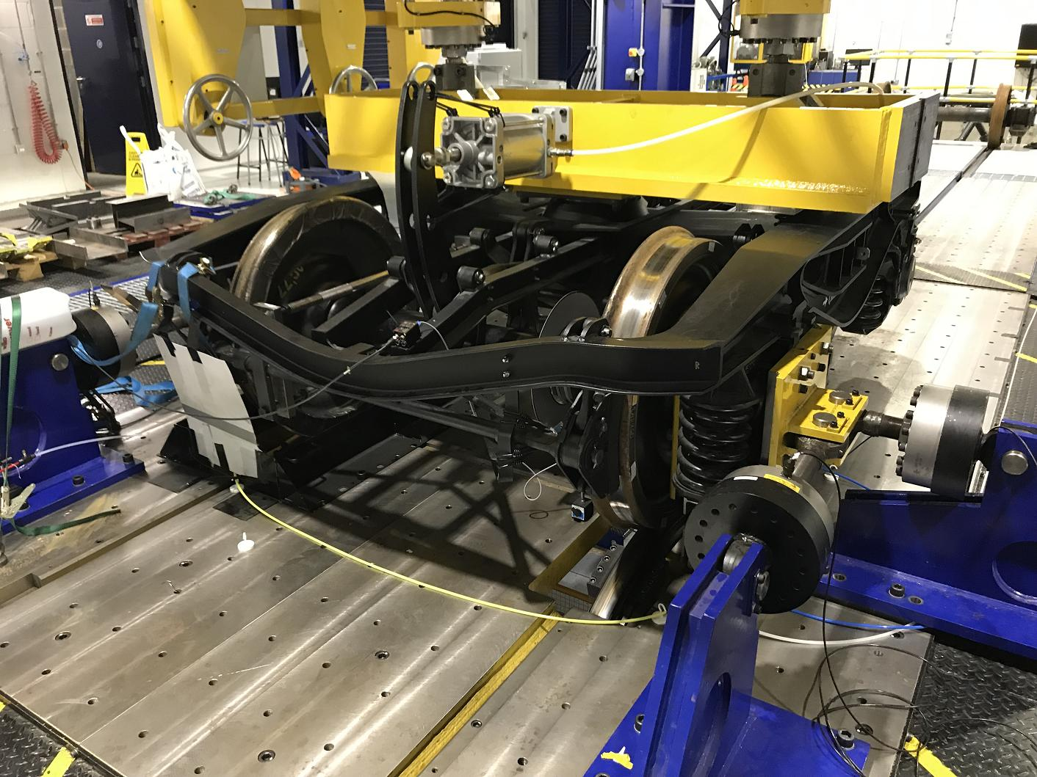
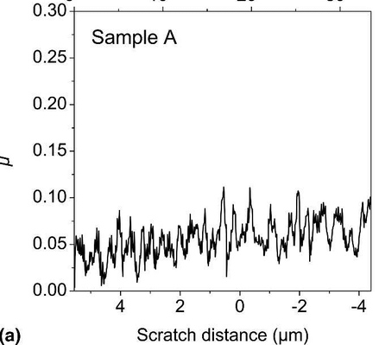
Choice of measurement
Notes:
So the first part of a good measurement is the choice of measurement it’s self. And remember here we are not just talking about measuring normal force. We are talking about everything that leads up to that single number that we are going to report or model. So this may include the choice of test platform that you use, it’s set up, the other parameters that you build into your test and any data processing that will come after the testing.
Often our choice of measurement seems simple, it is certainly presented this way in many papers.
In reality there are many options
Conditions as close to real world application as possible

Slide 32
Choice of measurement
Measure what matters the most as directly as possible (avoid proxy measures if possible)
Often simple in lab tests but difficult in real world applications
In conditions relevant to application
Introducing as little unnecessary variation as possible
Often in direct conflict
Notes:
Often our choice of measurement seems simple, it is certainly presented this way in many papers.
In reality there are many options
Conditions as close to real world application as possible

Slide 33
Controls
Buy steel
Polish samples
Cut in to samples
Apply PVD coating
Wear test
Process data
PVD coat and polish
No PVD coating
All of this in common
Equivalent heat treatment
All of this in common
Notes:
So the concept of a control test should be familiar to most of you, Controls are the best way to ensure that you are not confounding your independent variable with some unseen variable.
They are a test that shares everything with your treatment group apart from the treatment it’s self.
But there is actually more to it than this
Firstly we need to ensure that our negative control is as similar as possible to the treatment group
so in this case we may have applied a PVD coating at a high temperature and it might be reasonable to include a control to look at any changes that had made.
Likewise this treatment may change the surface roughness in some important way so depending on your experiment you may wish to control for those effects too.
The last thing to note about control tests is that they need to be relevant, so if this alloy is not something that you would ever use in service then it isn’t a relevant control to look at the uncoated version.
Like wise if you want to test a new type of oil then controlling against the dry contact isn’t relevant.

Slide 34
Controls
Buy aluminium
Polish samples
Cut in to samples
Anodise
Wear test
Process data
Buy steel
Cut in to samples
Polish samples
No PVD coating
Only this in common
Notes:
In these situations your most relevant control is what ever the current best practice is, but in that case you should realise that now your control is less powerful, now you have a lot of confounding factors with your intended change.
We will talk about this more but this is one instance where you would want to repeat your tests on separate batches of materials, doing all of these steps several times because you don’t know if you have bought steel samples that represent the mean or if you have by chance got some freak versions

Slide 35

Removing experimenter bias
A | B | C
Ag NP | Base oil | C NP
Base oil
Oil with C
nano particles
Oil with Ag
nano particles
Experimenter doesn’t get to see this until after:
Experiment
Data analysis
Post test analysis e.g. microscopy
A
B
C
Notes:
So I spoke in the introduction about how we can’t really trust ourselves to be objective especially if we have a preferred outcome for some reason.
So we have to deal with this when talking about measurement.
The easiest way to remove bias to your preferred outcome is if you don’t know what you are testing so If you have different products and they all look the same or you have not seen them, you can ask a friend to label them with numbers before you do the testing and only tell you which numbers relate to which specimens after you have done all of the testing and the data analysis. This way you can’t have a preferred out come as you don’t know what you are testing.
You can use this technique both during the testing and the data analysis, and it is particularly important when you are planning on doing some complicated treatment to your data.
And the best part is it shouldn’t matter at all for the results, this should just make it more fair, this won’t cost you any time or extra money
But I know what you are thinking, that this sounds great until it doesn’t work

Slide 36

Removing experimenter bias
Base oil
Oil with C
nano particles
Oil with Ag
nano particles
A
B
C
Notes:
So maybe your samples have obvious differences or particular safety requirements. It isn’t always possible to completely blind yourself for the full test and in these situations, you shouldn’t endanger anyone or just pretend that you can’t see what’s obvious.
But there are several ways of dealing with this

Slide 37
Partial blinding
Test plan:
Set up equipment
Calibrate force sensor
Clean next sample in acetone
Put sample in equipment
Run in for 50 cycles
Set test parameters
Add 20ml of test oil
Press go, record notes, don’t stop the test
Clean up
Process data
Analyse data
Can’t be blinded here
Notes:
Firstly you likely have a test procedure that looks like this, there are often a lot of steps leading up to the test that the experimenter can be blinded for so here everything up to adding the oil and pressing a button you can be blind.
If you are just looking at different forces or speeds the experimenter only needs to be blind until numbers are entered on a computer.
This will reduce the possibility of adding bias from the experimenter, but not completely eliminate it.
Like wise as soon as the experiment is over the experimenter can be blinded to the categories in the data, this means that they will have limited possibility of influencing the results during data processing.
Another strategy that you can try is to have someone else, who is disinterested in the results do either the testing or analysis. So for example you might have a student who needs more experience using the S.E.M. or a professional S.E.M. user do the microscopy, by giving them specific instructions of what to do but no idea what outcome you are hoping for you can also reduce bias in your results.

Slide 38
A strict plan
Test plan:
Set up equipment 100N load cell, medium suspension
Clean next sample in acetone 1 minute in ultrasonic cleaner, handle with tweezers after
Put sample in equipment etc.
Run in for 50 cycles etc.
Set test parameters
Add 20ml of test oil Over a 1 second period
Press go, record notes
Clean up
Process data Take the mean of the first 100 cycles after run in
Analyse data 2 sided t-test between samples
Notes:
Lastly as a weak measure you can have a very prescriptive test methodology that defines exactly what needs to be done to take a measurement.
Having clear written directions can help reduce bias, but if you do this you will need to carry out screening tests of these steps to ensure that your samples are in the same condition at the start of the test

Slide 39
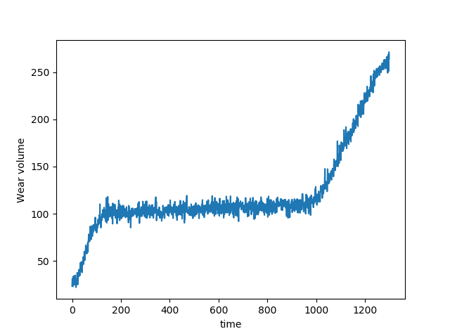
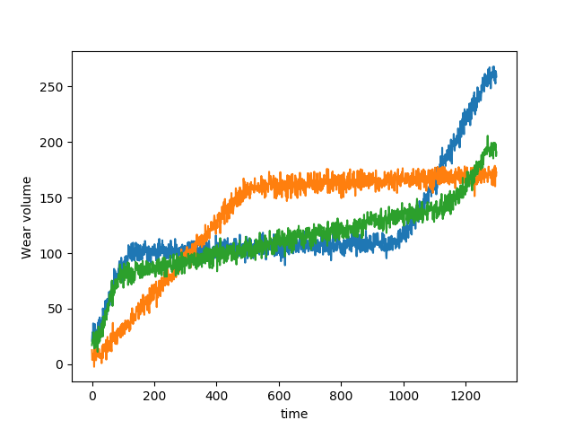
Data processing
Max friction
Friction force
Friction force
‘Steady state’ friction
Mean friction
Time to ‘failure’
Notes:
Any data processing should be thought of as part of the measurement, this is not something to be decided after all the data has been collected. It needs to be well defined and follow the same principals as the rest of the measurement selection process. That is it should be a relevant as possible for the application and introduce as little undue variation as possible.
So if imagine that this is the sort of friction data you are collecting there are many things that you could be measuring from this time series. The actual measurement that you make will depend on the application, but in any case you should have clear definitions of the terms that you are using and you should be aware of any bias that your definitions could introduce for similar time series.
So for example in this time series we can see that the maximum value is highly dependent on the length of the test, so if this time to failure had been longer we might get an artificially low value.
For disparate samples screening tests may be necessary to ensure that the process is not biased against a particular sample For any complicated analysis such as image analysis the method should be validated in detail to show any bias

Slide 40
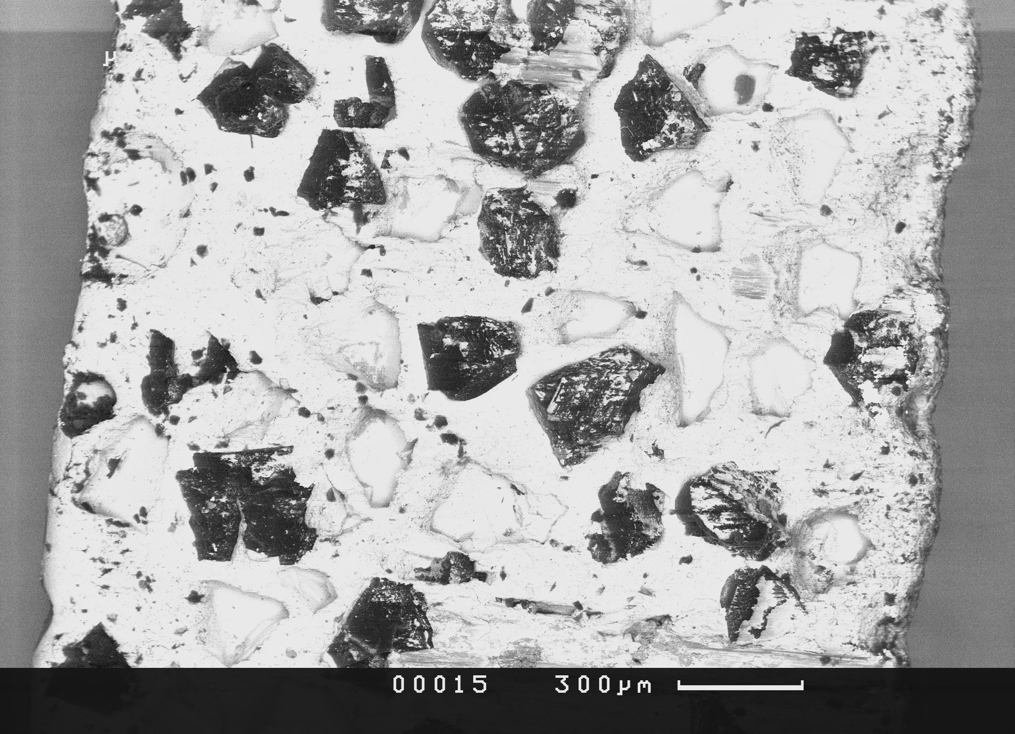
Quiz
Aim: Stephen has run a wear test on an abrasive grinding wheel, he wants to examine the surface to identify the failure mechanism
Method: Put the sample in an S.E.M. to look at the surface and take some pictures for the paper (reviewers love S.E.M. images)
Results: Images look like this, it looks like some abrasive grains are missing
Conclusion: The abrasive is failing due to grain pull out
Notes:
3-4 problems

Slide 41
Answers
The ‘missing grains’ might not have fallen out during the test or because of the grinding
The small image might not be representative of the wheel as a whole
The experimenter can introduce bias in which photos are taken
The experimenter can introduce bias in how the photos are analysed

Slide 42
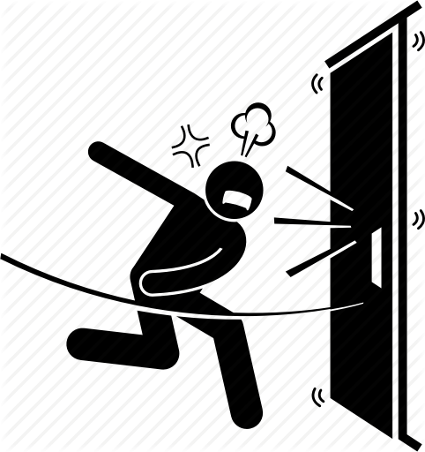
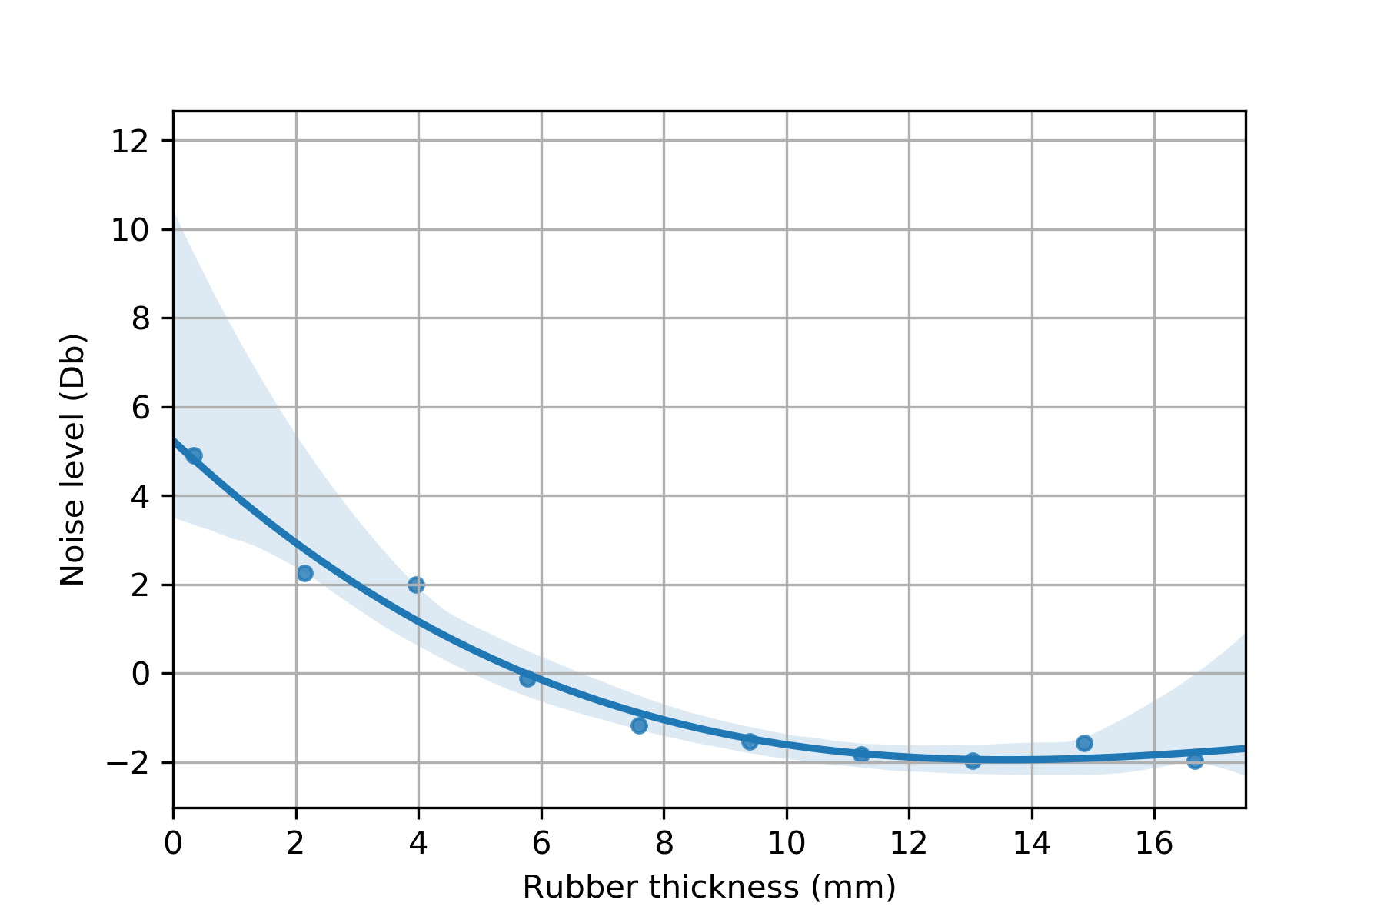
Quiz 2
Aim: A company makes ‘quiet slam’ rubber door stops. They want to make them quieter and/or cheaper.
Background: They have investigated making the rubber thicker but found that stops thicker than 10mm are no quieter
Method: They can test performance of door stops by manually slamming the door as hard as they can and listening to the sound they make
They will make 10mm thick door stops from new materials and test them
Notes:
Possibility to introduce bias from the door slammer
Introduction of needless variation
Measurement is optimised for a particular sample
Optimising an experiment for a particular sample, then hoping that the results tie over for all samples
Note that this is a simple example but we often take indirect measurements of things and it is possible that these will not transfer over we to other samples/ we also follow standard tests which can be optimised like this for particular samples.

Slide 43
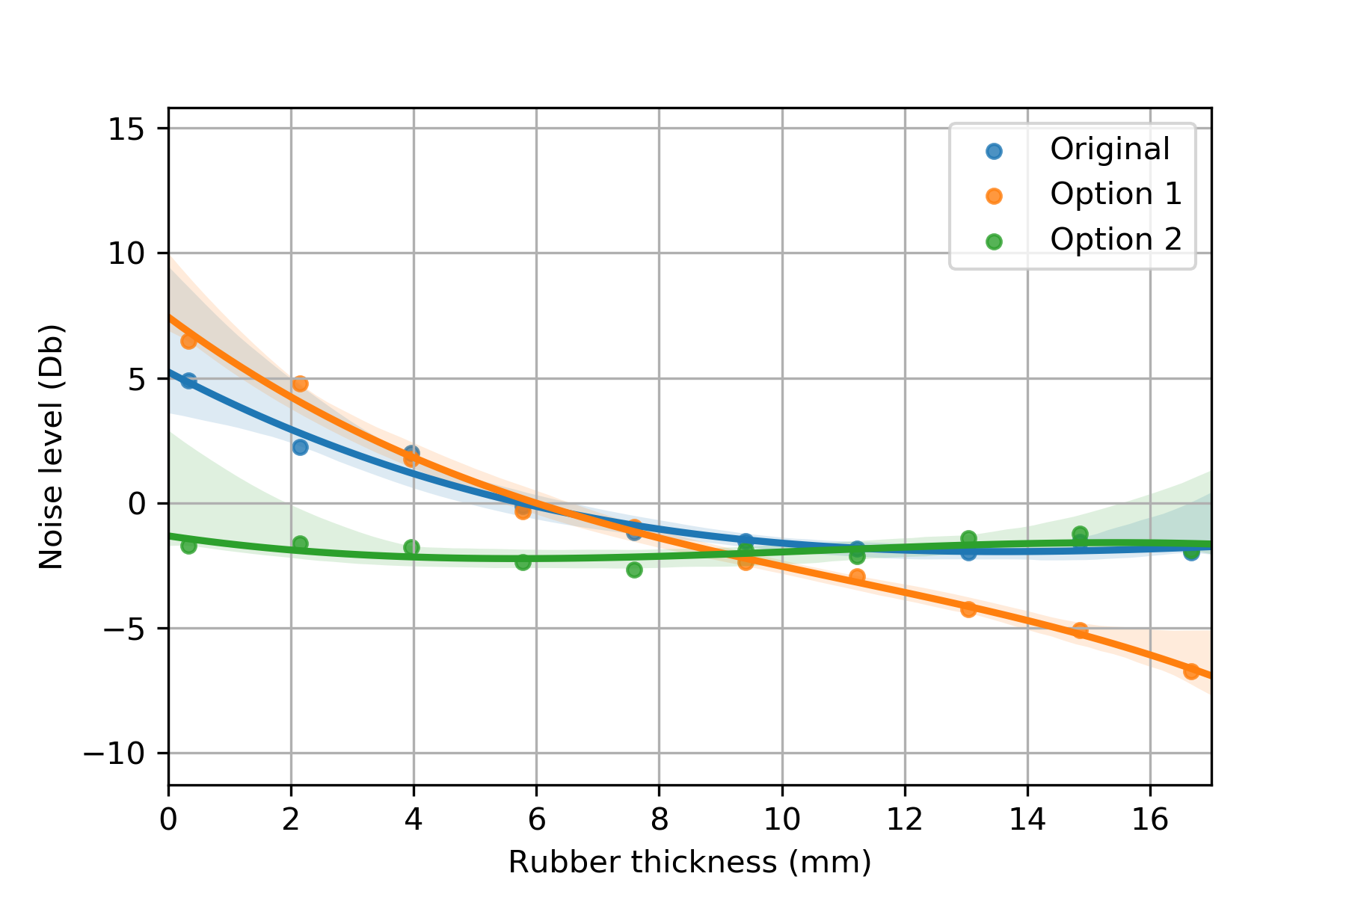
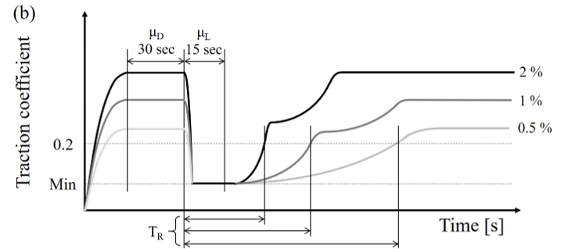
Answers
Manually slamming the door introduces unnecessary variation
The experimenter can introduce bias in the slamming and listening
The measurement is optimised for a particular sample

Slide 44
Removing bias from the experiment
A fair and relevant measurement
An unbiased experiment
A design that lets you model what you need
A fair modelling process
Notes:
Back to the same slide as for the what makes a good experiment

Slide 45
Having a clear hypothesis
Yes | No
‘Reduction in friction coefficient’ ‘Decrease in wear rate’ ‘Linear correlation’ Etc. | ‘Understand the mechanism’ ‘Characterise a surface’ ‘Investigate a process’ Etc.
Notes:
Having a clear hypothesis, is crucial for designing an experiment, this doesn’t need to be something that you have a reason to believe in, you but should be clear what the point of the experiment is before you try to design it.
This means that you can design the experiment to do exactly what you ned it to do,

Slide 46
Repeats
Repeat tests are how we take care of variation that we cannot control for
These are essential in any experiment
Notes:
Basic stuff on repeats mention that they need to be independent!

Slide 47
What counts as a repeat
2 things to consider, where your controls come from and how variable the population is likely to be
In what situations would you want to do different types of repeat tests?
Technical repeats deal with variation expected on identical (seeming) samples
Full repeats deal with variation expected between samples (eg when your samples are not very similar to each other or when you cannot control well)

Slide 48
Randomisation - Samples
Notes:
Fairness from the experimenter

Slide 49
Randomisation - Tests
Notes:
Fairness from the experimenter

Slide 50
When is random not enough

Slide 51
Quiz - 1
Sam wants to test the effect of anodising an aluminium surface on it’s wear life.
What controls and repeat tests should they run, what variation is this accounting for?
How would this change if they were thinking about replacing a steel part with an anodised aluminium part?
Something with 99.99% pure materials
Notes:
One about randomisation

Slide 52
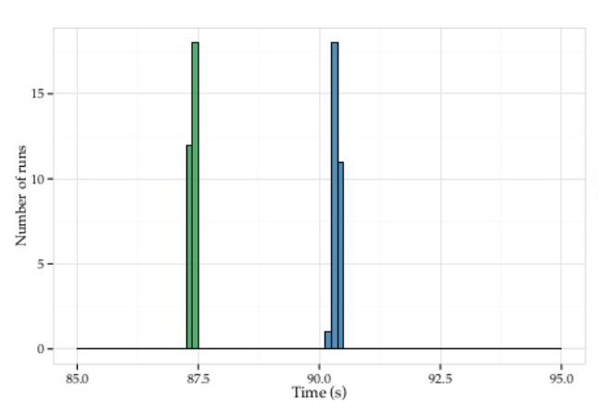
Quiz - 2
Aim: you have changed some computer code and you want to see if your changes have made it run faster.
Method: You compile both the original code and the new code then you run them both 30 times on your computer
The results look like this:
Conclusion: Our new version is faster!
Example from: https://emeryberger.com/research/stabilizer/

Slide 53
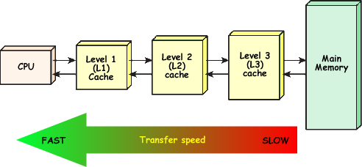
Quiz - 2
H0O_last_i_2
Depends on:
The user name
The current folder at compile time
Etc. …
Up to 40% change in speed
Notes:
Modern compilers are doing clever things that you can’t control. e.g. Some variables are assigned to the CPU cache (fast) and others are assigned to memory (slow). Which variables get assigned to which depends on many things including the environment variables, and these include your user name and the current working directory. These effects can change the speed of the program by 40%.
So someone, very clever invented a compile that changes these things over and over again while the program is running, so they are taking lots of samples and trying to get an idea of the overall distribution. And when they did that they looked at the speed ups people had actually achieved when they tried to speed up their code, but they looked at it independent of these effects.

Slide 54
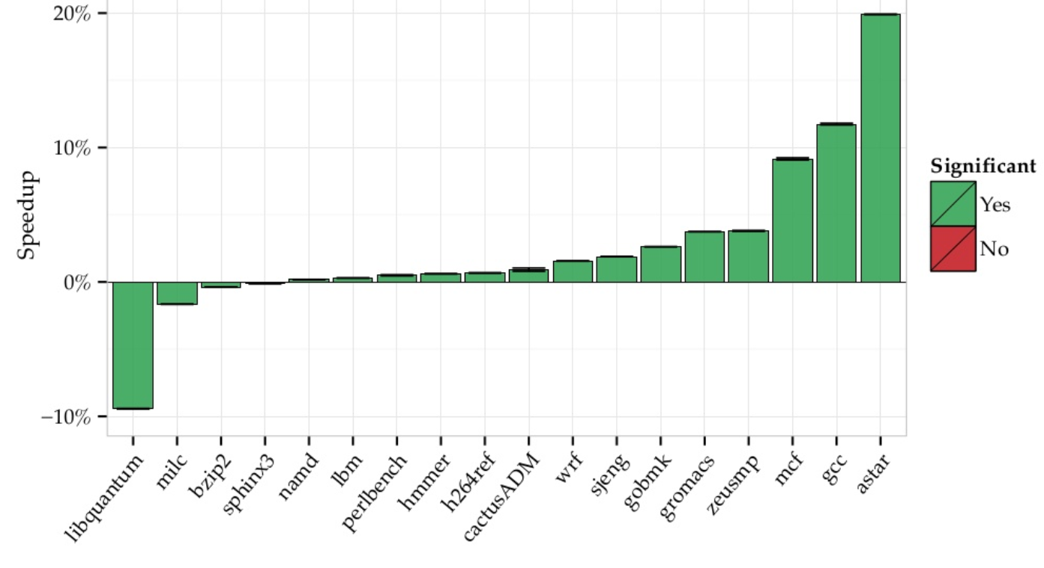
Quiz - 2
Notes:
And what they found was this, so most people did manage to speed up their code but a few people actually slowed it down by a lot.
Now, this may not seem to relevant for tribology, but I cannot think of a better argument for repeating your tests

Slide 55
Summary
Think of measurements as containing some real variation
Realise that experimenters cannot be trusted
Design your measurements so they are: relevant, reliable, unbiased not open to experimenter bias
Be aware of the possibility of biased measurements from complicated analysis
Use relevant control tests to avoid confounding
Repeat tests to assess the amount of variation and ensure that your results are representative of reality
Randomise or systematically vary your test samples and the order of your tests to avoid confounding with unknown variables

Slide 56
Break
I have a uniform block of material
I cut the block in half and give you both halves
Your next research grant depends on finding a false
positive difference between the halves
How would you design an experiment in your speciality to find a difference?

Slide 57
DOE: how to ‘spend’ your repeats
A fair and relevant measurement
An unbiased experiment
A design that lets you model what you need
A fair modelling process
The model and the design should
be considered together
Notes:
Back to same slide showing 3 parts

Slide 58
Choosing a model
Test one / or several specific hypotheses
E.g. does this surface treatment reduce wear
Is normal force correlated linearly with friction
Does one of these coatings give lower friction than the others
What do you want to do?
These are incompatible*
Model the system / generate hypotheses
E.g. model friction over a range of conditions
Estimate low wear conditions for a system
Estimate important parameters for a system
*mostly

Slide 59
What do we mean by testing a hypothesis?
Wear
Isn’t coated
Is coated
Notes:
We get a p value out. This is the probability of observing a result as or more extreme than the one we observed if the null hypothesis is true. Now typically people say that a p-value of less than 0.05, that is a 5% chance of getting these points from this distribution, is a statistically significant result.
This just means that it would be unlikely due to chance. It doesn’t mean that it is actually an important difference, if this is a 50,000 euro coating and this is a 0.01% improvement in wear life, no one cares!
Another important thing about this sort of test is that it typically has a 1 in 20 false positive rate, so we need to be careful about how we apply it.

Slide 60
What do we mean by testing a hypothesis?
Wear
Isn’t coated
Is coated
Notes:
We get a p value out. This is the probability of observing a result as or more extreme than the one we observed if the null hypothesis is true. Now typically people say that a p-value of less than 0.05, that is a 5% chance of getting these points from this distribution, is a statistically significant result.
This just means that it would be unlikely due to chance. It doesn’t mean that it is actually an important difference, if this is a 50,000 euro coating and this is a 0.01% improvement in wear life, no one cares!
Another important thing about this sort of test is that it typically has a 1 in 20 false positive rate, so we need to be careful about how we apply it.

Slide 61
What do we mean by testing a hypothesis?
Wear
Isn’t coated
Is coated
Notes:
We get a p value out. This is the probability of observing a result as or more extreme than the one we observed if the null hypothesis is true. Now typically people say that a p-value of less than 0.05, that is a 5% chance of getting these points from this distribution, is a statistically significant result.
This just means that it would be unlikely due to chance. It doesn’t mean that it is actually an important difference, if this is a 50,000 euro coating and this is a 0.01% improvement in wear life, no one cares!
Another important thing about this sort of test is that it typically has a 1 in 20 false positive rate, so we need to be careful about how we apply it.

Slide 62
What do we mean by testing a hypothesis?
Wear
Isn’t coated
Is coated
Notes:
We get a p value out. This is the probability of observing a result as or more extreme than the one we observed if the null hypothesis is true. Now typically people say that a p-value of less than 0.05, that is a 5% chance of getting these points from this distribution, is a statistically significant result.
This just means that it would be unlikely due to chance. It doesn’t mean that it is actually an important difference, if this is a 50,000 euro coating and this is a 0.01% improvement in wear life, no one cares!
Another important thing about this sort of test is that it typically has a 1 in 20 false positive rate, so we need to be careful about how we apply it.

Slide 63
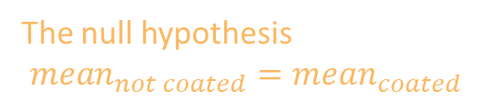

What do we mean by testing a hypothesis?
Our hypothesis
$mean_{not coated}>mean_{coated}$
Wear
The null hypothesis
$mean_{not coated}=mean_{coated}$
P=0.049*
Isn’t coated
Is coated
Notes:
We get a p value out. This is the probability of observing a result as or more extreme than the one we observed if the null hypothesis is true. Now typically people say that a p-value of less than 0.05, that is a 5% chance of getting these points from this distribution, is a statistically significant result.
This just means that it would be unlikely due to chance. It doesn’t mean that it is actually an important difference, if this is a 50,000 euro coating and this is a 0.01% improvement in wear life, no one cares!
Another important thing about this sort of test is that it typically has a 1 in 20 false positive rate, so we need to be careful about how we apply it.

Slide 64
What do we mean by testing a hypothesis?
Our hypothesis
Y = mx + c
Friction force
The null
hypothesis
Y = c
Normal force
Notes:
So imagine that this is our data and we think that there is a linear correlation between force and wear. To test this, we can test against the null hypothesis. And the null hypothesis just says what ever you think is happening, it isn’t. so you think that there is a linear correlation, the null hypothesis say that there is no correlation, that the slope of this line is actually 0.

Slide 65

Quiz
Lisa did some friction tests on 5 new oil additives that were designed to lower friction.
She statistically analysed the result and none of them significantly reduced the average friction compared to the base oil.
As well as friction she measured wear, temperature, oil particulate content and post test fatigue strength.
Should she statistically look for changes in these?
Bonus: She also notices that one of the products looks like it gave low friction for the last quarter of the tests.
Should she statistically test the results from the last quarter of each test?

Slide 66

Multiple comparisons
Every comparison you make increases your false positive rate
There are many methods for dealing with this, these are included in statistics packages
You should be aware of situations where you may be making a lot of comparisons informally. Or where many possible results could come out and seem important
Processing time series data is particularly bad for this
One solution is to define your processing in advance and stick to it, don’t let the data guide your analysis
Gelman, A., & Loken, E. (2014). The garden of forking paths: Why multiple comparisons can be a problem, even when there is no “fishing expedition” or “p-hacking” and the research hypothesis was posited ahead of time. Psychological Bulletin, 140(5), 1272–1280. https://doi.org/dx.doi.org/10.1037/a0037714

Slide 67
Another Quick Quiz
You have run three wear tests of a new coating and three control tests of the current coating. The new coating is cheap so any real improvement is worth while.
You statistically test the outcome of your wear tests with an appropriate test
The p-value is 0.051 – not significant, but very close
Can you add another wear test and re-do the statistics?
Wear
P=0.051
Is coated
Isn’t coated
Notes:
We get a p value out. This is the probability of observing a result as or more extreme than the one we observed if the null hypothesis is true. Now typically people say that a p-value of less than 0.05, that is a 5% chance of getting these points from this distribution, is a statistically significant result.
This just means that it would be unlikely due to chance. It doesn’t mean that it is actually an important difference, if this is a 50,000 euro coating and this is a 0.01% improvement in wear life, no one cares!
Another important thing about this sort of test is that it typically has a 1 in 20 false positive rate, so we need to be careful about how we apply it.

Slide 68

Repeats and hypothesis testing
Adding repeats and re-testing the result increases the false positive rate
Repeats added after the main experiment may differ from the main experiment in important ways
The number of repeats needs to be decided in advance of any testing!
Notes:
How many repeats should you do, start this section with the example of running repeats until you get a positive result, lead into this meaning that you must decide in advance how many repeat tests you are going to do.

Slide 69

How many repeats do I need?
The statistical power of an experiment is how likely it is to find an effect if the effect is present
For any statistical test there is a function that relates this to:
The threshold p-value that will be used
The size of difference you are interested in
The variation in the population
The number of repeat tests
We can use this function to decide how many repeats to do!
T-test power for effect size = 2

Slide 70
Designs – Two means
The simplest design
Introduction to pairing
Example of graph you might get out
What statistics should you use to test the result
Notes:
You are testing relatively simple things about your system, you want you results to be simple to present and understandable by the people you present them to.
This needs relatively simple designs, OFAT, or factorial designs mostly, Note about

Slide 71
Designs – Several means
Simple extension to two means
Several different groups
Pairing between groups still ok
Example graphs you might get out
What statistics do you use to test, notes about post testing and robustness to non normality

Slide 72
Designs – Regression
Different sort of design
Example of plots that you might get out
What statistics would you use to test

Slide 73
Experimental designs for modelling
Aim: To model the system as accurately as possible
Notes:
OLS models, NNs, GP models, they do not require as many assumptions but do not tell you as neat things about the system, these are also open to bias in the data set

Slide 74
Factorial designs
A 2 level n-factor

Slide 75
The Latin hypercube

Slide 76
Exercise – Swap to Jupyter

Slide 77
Classification vs regression designs
Notes:
Classification designs you need to make sure that you have similar numbers in each class, regression you need to make sure that you cover the input space well.

Slide 78
Dealing with outliers

Slide 79
Presenting your results
Always plot out predicted vs actual value plots, QQ plots and simple box plot
Give away your code and data if possible, you are not infallible, this way people can find mistakes

Slide 80


What is R²?
Often quoted as the goodness of fit of the model.
It is given by:
$R^{2}=1 − \frac{\sum_{i}{{(y_{i}−f(x_{i}))}^{2}}}{\sum_{i}{{(y_{i}−\overline{y})}^{2}}}$
1 indicates a perfect fit, 0 indicates that the model is no better than the mean and negative numbers mean the model is worse than the mean.

Slide 81


R² some examples

Slide 82


What it doesn’t tell you

Slide 83


When can R² be misleading?

Slide 84





Effect of measurement range on R²
Actual function is:
$\text{y}\text{ = }\text{x}\text{ + }\text{sin}\text{(}\text{x}\text{) + }ϵ$
Fitted with a linear model
Increasing the range increases the R² value
Individual points are not better estimated because of the larger range

Slide 85
Iterative methods

Slide 86
Feature engineering
Notes:
If you know in advance that some feature is important, even though it may be a combination of other values or a transformation of values the experiment should be designed around this feature rather than the underlying variable, You can also communicate these features to the people doing the modelling to improve the accuracy of the model. Note that this sits somewhere between the two paradigms

Slide 87
Choosing a model
A model that tests your hypothesis
Understand all assumptions built into model
Minimise number of comparisons
Decide on number of repeats in advance
Test one / or several specific hypotheses
E.g. does this surface treatment reduce wear
Is normal force correlated linearly with friction
Does one of these coatings give lower friction than the others
What do you want to do?
A model that represents your data well
‘Black box’ models sometimes acceptable
Make several comparisons find ‘best’ parameters
Let the data ‘speak’
Possible to add data and remodel
Model the system / generate hypotheses
E.g. model friction over a range of conditions
Estimate low wear conditions for a system
Estimate important parameters for a system

Slide 88
How is machine learning different
Notes:
It isn’t, it still has the same pitfalls as anything else, example of fish recognition, example of tank recognition, other examples?

Slide 89
The end

Slide 90
What are the model coefficients?
A larger coefficient doesn’t mean a more important effect if the data are not normalised
Even with normalised data the effects must be compared with reference to the measurement range
Notes:
Some common pitfalls/ what does a p value actually mean, maybe you should talk about this earlier?

Slide 91

A case study
Machining carbon fibre composites:
Surface roughness is important for strength and fatigue properties, we want to know how this changes with feed rate tool speed and tool wear.
Researchers have run experiments to model the changes in roughness with respect to machining parameters previously.
But recent work has shown that the roughest ply is most important
Plys have 4 possible orientations: (135 or -45, 0, 45 and 90º)

Slide 92


Case study

Slide 93

Case study
R² for roughest ply is 0.06
no correlation with ‘overall’ model

Slide 94

Case study

Slide 95

What is the p-value
$p=P\left(X≥|x| \right|H_{0})$
The probability
Given
Of making an observation
The null hypothesis being true
As or more extreme
Than the actual observation

Slide 96


P-value for dice
You are playing snakes and ladders with your son, you think his dice might be weighted so they only roll sixes!
You want to check before you agree to play so you set up an experiment to test them:
You roll the dice and get a pair of sixes!
The probability of this happening for fair dice is 1/36
We can’t roll three sixes or two sevens so this is the most extreme example
$p value=P\left(X≥|x| \right|H_{0})=P\left(x\right|H_{0})=\frac{1}{36}=0.028$*
Conclusion: this is a significant result so you reject the null hypothesis, the dice are weighted!
Notes:
So I think we can all agree that this would be bad parenting, if not outright psychopathic. But why, and if it is bad parenting, is it also bad science, people accept results on this sort of evidence all the time.

Slide 97

How does the p-value relate to the chance that the null hypothesis is true?
$P\left(H_{0} | x\right)= \frac{P\left(x\right|H_{0})P(H_{0})}{P(x)}$
Where $P(x)$:
$P\left(x\right)=\sum_{i=0}^{n}{P\left(x\right|H_{i})P(H_{i})}$
$$P\left(x | H_{0}\right)≤p value, P\left(X≥|x| \right|H_{0})$$

Slide 98

Dice extended
Lets assume that there is a 1/1000 chance that a given pair of dice (in the situation yours are in) are weighted.
And lets assume that there are only 2 possible hypotheses: the dice are both weighted and always throw a 6 or the dice are both normal dice:
$P\left(x\right)=\sum_{i=0}^{n}{P\left(x\right|H_{i})P(H_{i})}=\frac{1}{36}∗0.999+1∗0.001=0.029$
$P\left(H_{0} | x\right)= \frac{P\left(x\right|H_{0})P(H_{0})}{P(x)}=\frac{0.028∗0.999}{0.029}=0.96$
So the dice are probably not weighted.

